Slide 1





Empowering
Communication
The VoIP Enabler!
Cohesive Technologies Pvt. Ltd

Slide 2








A
bout Cohesive Technologies
NEPAL
BHUTAN
Enterprise
Empowering Communication
MYANMAR
DUBAI
BANLADESH
TUNISIA
OMAN
SRILANKA
PHILIPPINES
MALDIVES
MALAYSIA
SINGAPORE
- Headquarters
- Registered Office
- Cohesive global reach
100+
20+
35%
20%
Award
0.1%
100+ Employees
20+ PAN India and regions covered
Compound Annual Growth Rate reaches 35% from 2013 to 2020
20% of office staff are working in R & D center
Less than 0.1% defect rate
CS-4, 5 & 6, 4th Floor, Ansal Plaza, Sector 3 Vaishali, Ghaziabad (Uttar Pradesh.) 201010
169, FIE, 1st Floor Patparganj Industrial Area, Delhi-110092, India

Slide 3



















S
egment We Cater & Technology Partners
Enterprise
Education
Healthcare
Residential
Automobile
Telecom
Financial
Empowering Communication

Slide 4
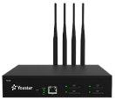
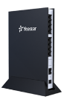


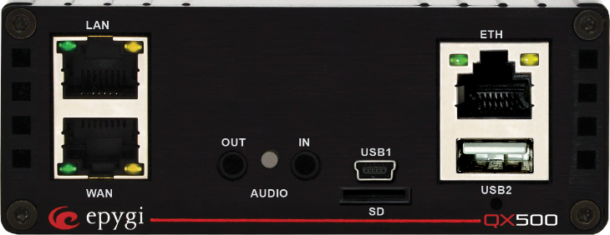


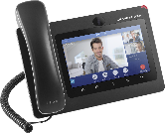
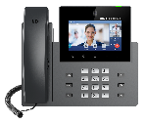
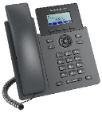
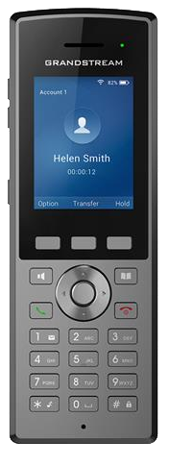
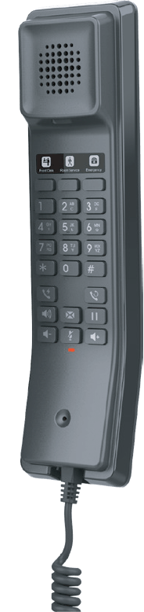
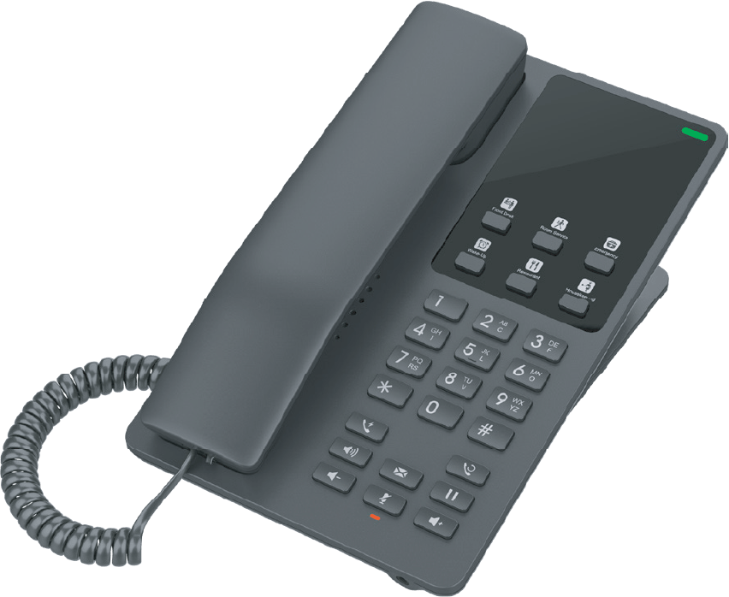

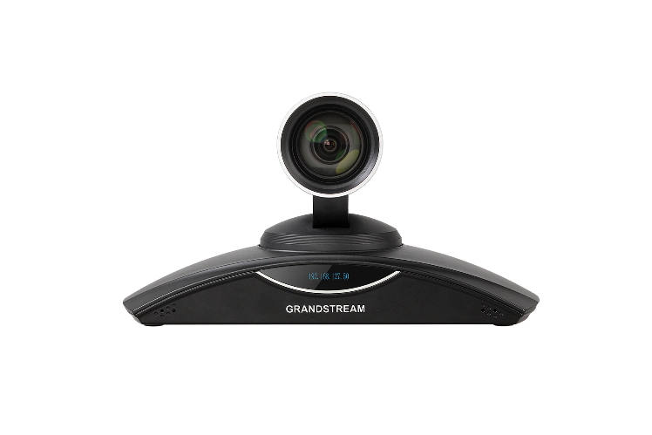







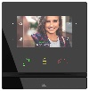



P
roduct Portfolio
Gateways & ATAs
E1/T1/J1 Ports
FXS & FXO Ports
Voice Conferencing
concurrent calls
Nat Traversal
Empowering Communication
Unified Communications
Upto 5000 Extension
Redundancy, voicemail, Recording
call center features
Integrated with 3 party products
Linkus App, Auto Dialer
Automatic Call Distribution
IP Video Telephony
16 SIP ac, Video Calling
Instant Messaging
Bring Your Own Device (BYOD)
Security and On-Premise Access
Employee Access
Huddle Rooms
IP Voice Telephony &
IP Hotel Phones
2 - 6 SIP accounts
Common-area phones
color screen, HD audio
Noise-shield technology
Enterprise-grade security
WiFi Cordless IP Phone
Bluetooth, wifi, BLF Keys
Audio/Video Conferencing
Runs on Android 9.0 operating system
Support for up to 300 participants and 120 video feeds per session; up to 10 simultaneous sessions
video and audio recording
1080p Full-HD video
Bluetooth, WiFi support
Built-in Mic/Speaker
PAN, TILT, ZOOM - camera
IPVideoTalk Meetings Platform
2011~
2013
IP Access Control & SW
Slimline design
Fastest mobile access
Bluetooth, IP55 and IK07
Controller and reader in one
Encrypted two-way communication
Perfect for the office or outdoor
2014
Smart Home
Automation
Smarter Home,
Sweeter Life,
Zigbee Hub. Intercom. Smart Home Control Panel in One
Answering Units
Luxury design with top materials
Smartphone as answering unit
Home automation integration
HD quality sound with ambient noise suppression
SIP Door Intercom
Intercom is a first access control device you will get in touch before you enter a building
It has to look very luxury in villas or MDUs
HD audio & video quality

Slide 5
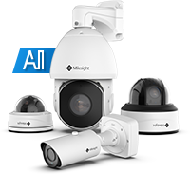
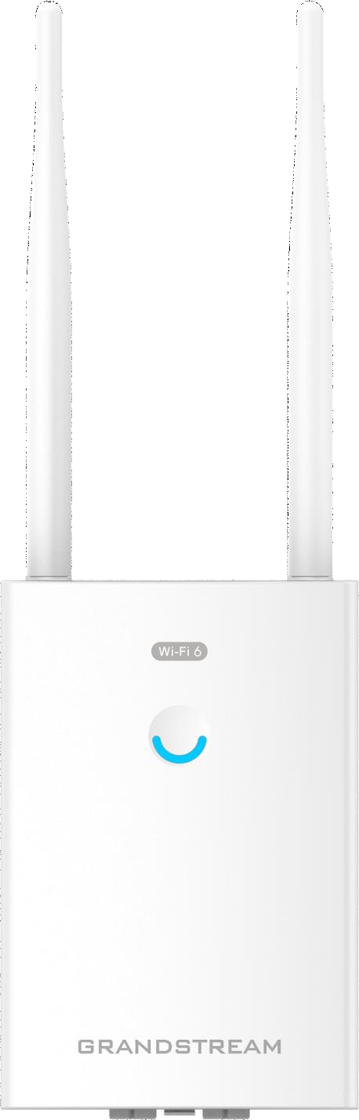


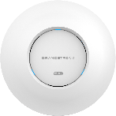
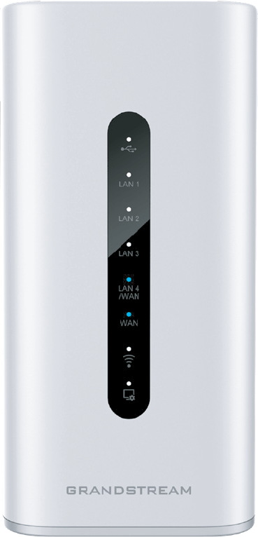

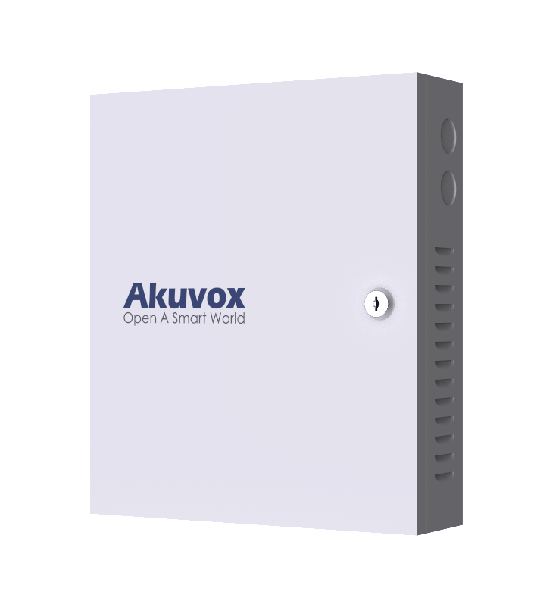
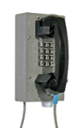
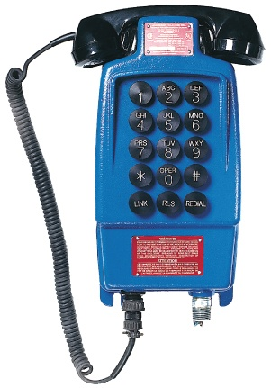
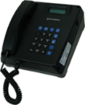

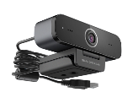
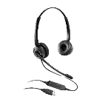
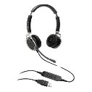
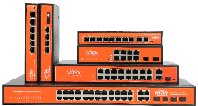
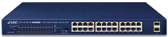
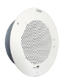

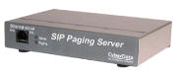
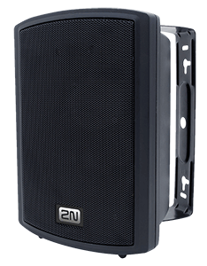
P
roduct Portfolio continue…
SIP Surveillance
Introduced H.265+ & Starlight & WDR
Debut of the unrivaled Mini PTZ Bullet Camera
New technologies: Auto Tracking, Advanced Heat Map and High-quality Deblur...
Release AI ANPR solution & Pro Bullet Plus (with 3D Radar Module)
Launch enterprise VMS
Empowering Communication
Wireless Access Points
& Routers
OFDMA technology
Range upto 300 meters
IP66-level weatherproof capability
GWN Cloud, GWN Manager, Embedded Controller
Elevator Management
Convenient for the residents
to get in and out without cards
to avoid residents
IP & Analog Industrial Phone
Hazardous & Non Hazardous
Water Tight, Weather/Water Resistant Phones
Food Industry Industrial Telephone
Correctional Institute Industrial Telephone
Call center solutions
Inbound/Outbound calls
Contact center on cloud
IVR, Auto dialer, Automatic Call Distributor
Hosted Call Center
2011~
2013
Personal Collaboration Devices
RJ9, USB & Wireless Headset
USB Webcam supports 1080p Full HD video
Designed for remote workers, contact centers and other busy environments.
Comfortable, cost effective, durable headset for Soho, VoIP, IP-phone
Light weight design, practical IP telephony sound quality
2014
Networking Switches
GREEN Networking, smart LCD
Port VLAN, Watch Dog
IP65, support 30-60W each port
Redundant Power
Industrial switches (-40℃～ 80℃)
Solar UPS/ outdoor Weather-Proof
Switches
250 m CCTV Long-Range switches
SIP Public Address System
SIP/Multicast/Informacast/Syn-App
Serverless IP paging solution
Communication with SIP devices
Integration with VMS via ONVIF
Loudest Sound in the market

Slide 6


Epygi Solutions for MSPs
Notes:
Add product image

Slide 7






Epygi
American company with top notch development team designing products from the ground up. About 25 employees. Offices in Orlando, Dallas and Yerevan.
Based on proprietary SW and HW. NOT open source Asterisk.
Shipping PBX and gateway appliances for 23 years.
We also have cloud services with ecMON and ecQX.
Focusing on: SMB, Contact Centers, Hospitality, Health, Educational Institutions, Government, Multisite.
Provides SW/HW development services to 3rd party companies.

Slide 8
Epygi Advantage to the Channel
Mature, feature rich, quality products.
Reliable.
Free SW maintenance for life. Support portal.
Use your own SIP endpoint.
Use your own SIP trunk.
Customized softphone with eQall.
Excellent technical support.
Product is constantly improving. We always add new functions. Tell us what you want and we can fine tune the product.
No hidden/upfront costs.
Very good price point.
Best of both worlds. Cloud and on premise products.
We don’t sell to end users. We do not publish our prices.

Slide 9
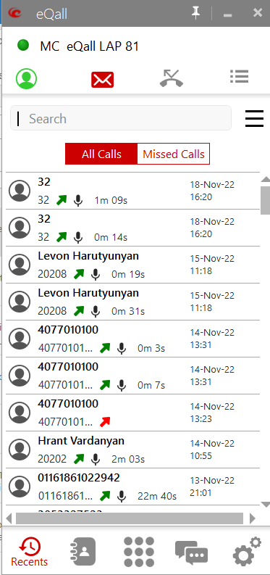
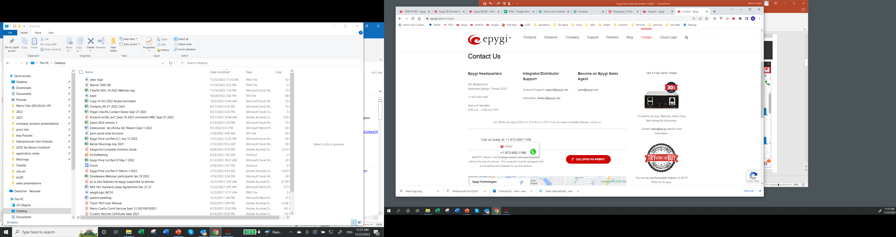
Epygi Advantage to the Channel
Enhanced Epygi eco-system:
  MS Teams integration
  Vtiger/Salesforce/ZOHO CRM integration
  Hospitality PMS for hotels
  WEBRTC
  Chrome Extension Click to Dial
  Outlook Click to Dial
  Works with SIP based door openers, cameras, paging adapters
  ecMON Cloud monitoring/admin service

Slide 10
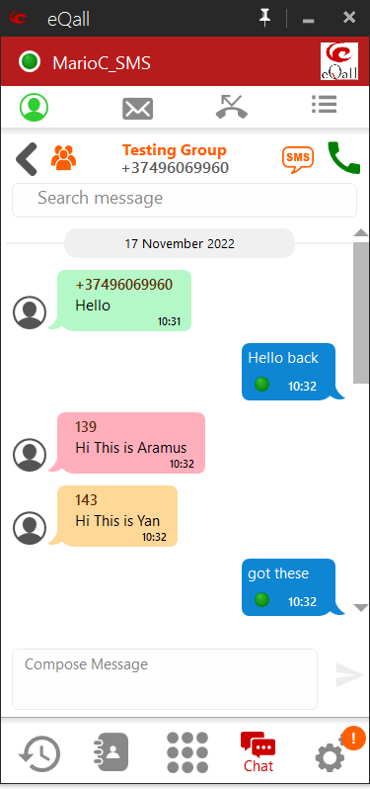
Epygi Advantage to End User
Mobility. Work from home, office or anywhere. eQall softphone
Clear voice.
Secure system.
Feature rich.
Reliable.
Flexibility. Many SIP endpoints can be used.
Very competitive prices. End user saves money.
Advanced functions tailored for end user business needs.
Use your preferred SIP trunk provider.

Slide 11
QX IP PBX Appliances
Appliances for offices from 16 up to 5,000 extensions.
Supports traditional analog telephones and PSTN trunks.
Complete feature set in base device plus advanced licensed functions.
  Dial and Announce, Parent/Child, Park and Page, Multiple IVR, Call Center
Auto configures many brands and models of SIP phones.
Includes network and security functions (SIP IDS, basic router and VPN).
Compact, modular and low power consumption.
Redundancy option.
Power redundancy.
Rack mountable using our Rack Kit.

Slide 12



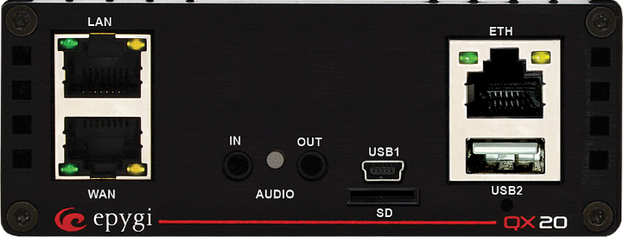

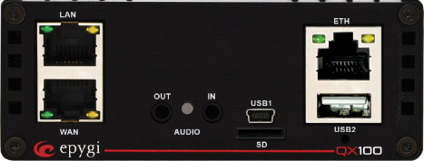




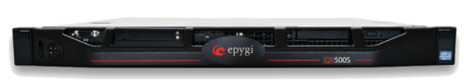

QX PBX Appliances

Slide 13
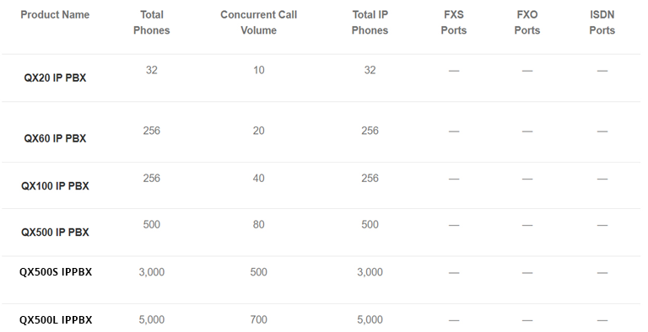
QX PBX Appliances

Slide 14
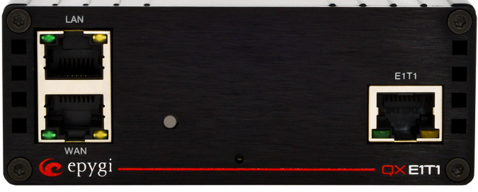
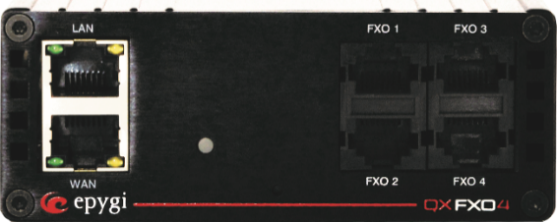

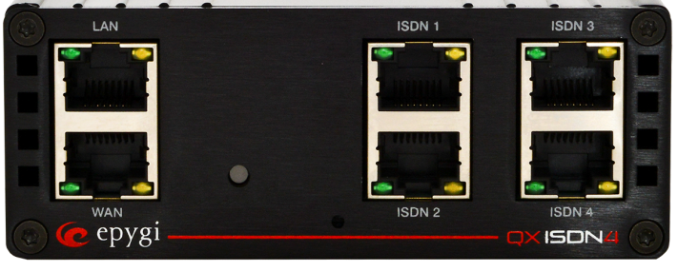
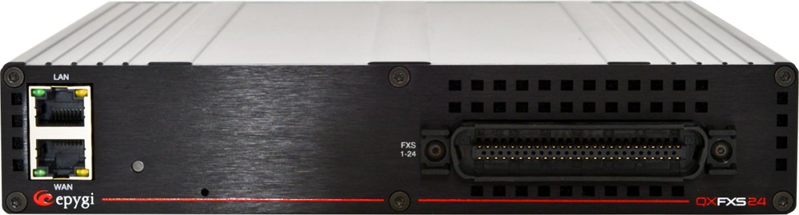
Gateway Models

Slide 15
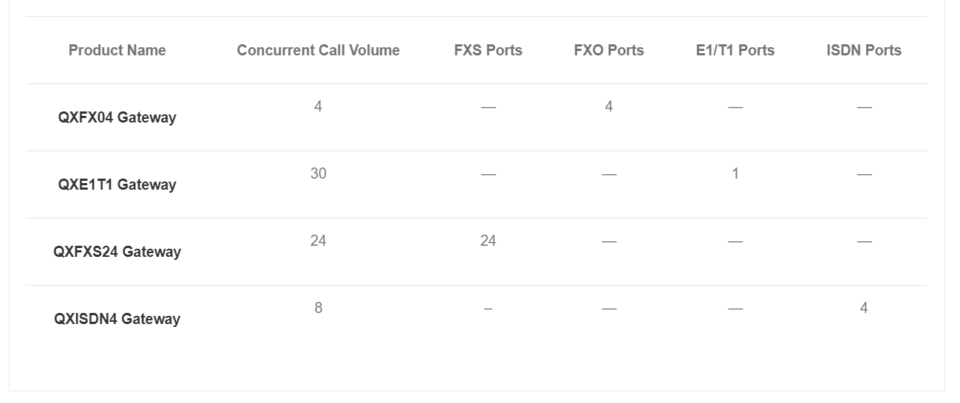
QX Gateways

Slide 16
Usage Scenarios
  Depending on the type of business some PBX functions are useful and present an opportunity to differentiate the solution from others.
  SMB – small business needs mobility, to be accessible by their customers, direct calls depending on their status or time of day, access control.
    Parent/Child extensions with eQall, FMFM, MER
    IVR, General Voice Mailbox, Day/Night call service
    Group Pickup, Audio Conferencing, Phone Book
  Enterprise Customers – remote users, people that work from home, receptionist, multiple trunks/IVR, WEB sites with click to dial, small call centers with recording, mobility, system reliability.
    Hot Desking, Multiple IVR, IVR History, Receptionist Console
    Class of Service, Hold Music playlist, WEBRTC
    Pin Code Authorization, Paging, Call Parking
    Call Recording, Paging groups, Emergency Interrupt, Redundancy

Slide 17
Usage Scenarios
  Schools – need to page multiple zones, emergency/activity announcements, class change doorbell, access control.
    911Alarm, Dial and Announce, Scheduled Alarm, Paging, SIP Door Access devices
  Retail – distribute incoming calls to diverse departments, reach staff in the floor/warehouse, open times/dates, push to talk for associates
    Park and Page with multiple IVR, Night Service, Paging, Holiday Scheduling, eQall for mobile devices, intercom
  Hotels – similar needs to schools with emergency and paging zones, scheduled activities, limiting long distance phone use, managing the room phones for guests, PMS integration
    Analog FXS ports, paging, Class of Service, Dial and Announce, Scheduled Alarm, PMSLink activation.

Slide 18
Usage Scenarios
  Multisite – Business with several locations/local trunks. Need to dial all employees, route calls for least cost.
    Multi Company Receptionist, Unified Dial Plans, Call routing based on dialed number, local/global IVR, peer to peer connectivity.
  Call Centers – Local or remote agents, real time dashboards, multiple call queues, agents working one or more queues, multiple supervisors, recording and performance monitoring tools, IVR or direct dialing to queues, customer options while on queue, reliable system.
    Hold Music playlist, opt out options, queue wait times, IVR history, IVR survey, call recording
    EAC – Epygi ACD Console (WEB based agent/supervisor console)
    ACD – Automatic Call Distribution (to create queues/agents)
    AOC – Automatic Outbound Calling (for outbound call centers)
    Barge In – supervisor/agent coaching/monitoring

Slide 19
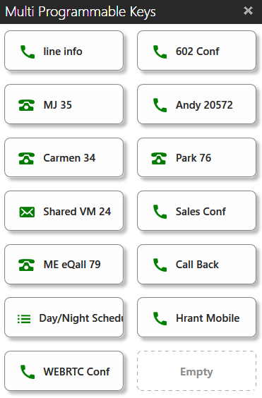
eQall - Epygi Softphone
eQall is a softphone application for Android, Apple IOS and Windows
eQall has several features:
  PBX, Outlook, mobile directories and favorites.
  Voice Mail indication and retrieval
  Call History
  Presence
  Separate ring device option
  Instant Messaging and SMS
  Multiple SIP accounts and line appearances.
  Your own logo.
  20 programmable keys (DND, call park, watched extn, speed dial, CR, agent login)
eQall is included on the ecQX cloud extensions hosted by Epygi. Paid license for QX appliances.
A Receptionist Console option is available.
Configure as parent/child on QX and work from home.

Slide 20
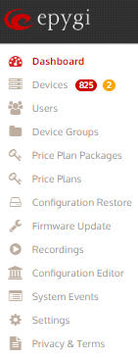
ecMON
ecMON (Epygi Cloud Monitoring Service) is a cloud-based service run by Epygi for resellers to manage QX appliances and ecQX cloud based PBX instances.
It allows configuration management, monitoring and alarm reporting of QX events.
ecMON offers the resellers a tool to provide better service to their customers:
Be alerted of events on the customer PBX and to respond quickly.
Avoid having to wait for customer to call with problems. Be pro-active and not reactive.
Maintain the customer system and monitor its performance.
Change customer device configurations remotely quickly without the need to be on site.
Information on licenses, registered phones, SW versions, concurrent calls, configuration backup, MOH, etc.

Slide 21

QX PBXs’ Enterprise Features

Slide 22
Enterprise Features (license)
ACD – for inbound calls. Based on queues and agents that answer incoming calls to queue. Several distribution types and options for callers, queue messages and actions. Can be used with EAC for added flexibility.
Auto Dialer - Windows application for automated outbound dialing from the QX. Plays recorded messages and allows customers to press digits and automate actions.
Barge In – Whisper, 3-way call and Listen-In modes for supervisors to monitor agent calls.
Call Recording – Based on simultaneous recordings. Store in QX recording box or external FTP drive. Can trigger any inbound or outbound call. Can also program record button on phone. Password option to review recordings.
Audio Conference – based on simultaneous participants. Complete audio conference server with scheduled conferences, password to join option, recording option, moderator mode and EMAIL reminders. Can have several conference rooms.
Video Conference – Add on to the audio conference. Allows video phone users to see the person speaking on the conference. Can mix video and audio phones.

Slide 23
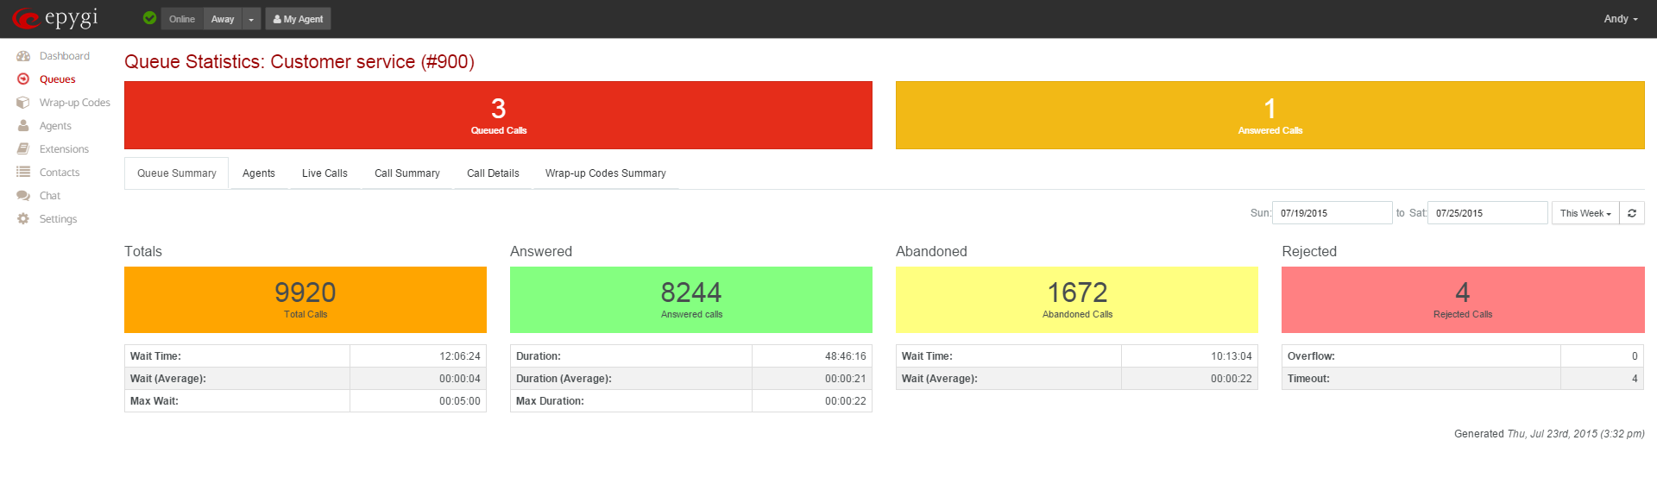
Epygi ACD Console (EAC)
EAC – WEB based tool. Agent/supervisor console for ACD.
Agent Management login/logout, busy etc.
Agent statistics.
IM tool for chat among agents and supervisors.
Scrolling Marquee for supervisor.
Call Control.
Wrap up codes with wrap times.
Direct WEB Access to QX. No need to install application
Available on all models.
Annual renewable license. Includes ACD.
Want to see a demo?

Slide 24
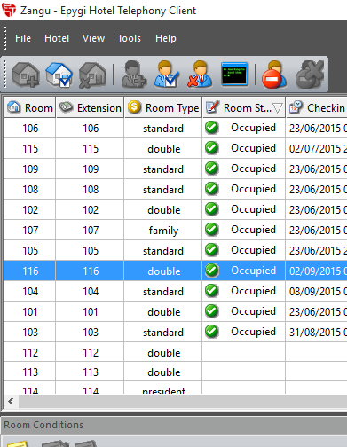
Epygi Hotel Console (EHC)
EHC – Windows application for small hotels.
Provides check in/out of extensions and control of room phone use.
Activation/deactivation of extension and clearing of voice mail.
Call billing with calling plan rates. Post or prepaid minute use option.
Minibar inventory and room status can be entered by personnel using the phone
Wake up calls and do not disturb mode.
Login of hotel personnel.
Spanish option.
Want to see a demo?

Slide 25

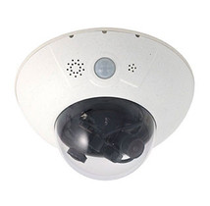
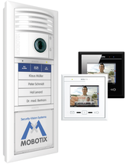

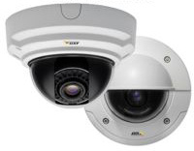
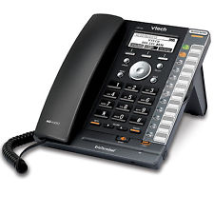
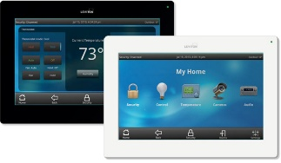


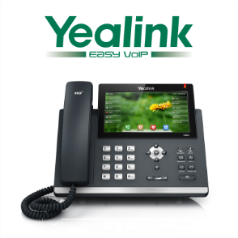




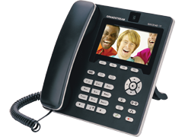



New Partners
Open NEW opportunities for integrators. MORE revenue. One stop shop.
  Video Phones – Polycom, Fanvil, Yealink, Grandstream, Bria
  Door Openers – Mobotix, Cyberdata, Alphatech, Axis, Viking, 2N and others
  Video Cameras – Mobotix, Grandstream, Axis
  Paging Adapters – snom, Cyberdata
  Other Devices – Leviton

Slide 26













Usage Scenario - Small Office
FMFM
Door Opener (many extn, VM, mobile after hours)
Security Camera
Touchscreen
SIP/PSTN calls
Door Opener
(x 200)
Mobile with Softphone
(Bria Video)
ITSP
Local
QX
WAN
LAN
FXO Line
(x 203)
(x 201)
Home Phone
Audio Phone
Leviton Omnitouch
(x 205)
(x 204)
Security Cam
(x 202)
Audio Phone
Notes:
Incoming calls go to AA. From there you can hear recording to select sales , support , etc. and using multiple extension ringing (MER) can ring several phones for example 201, 202 and 203. Also can dial specific extension from AA say 203 and using Find Me Follow Me you can be reached on 203, on mobile or at home phone.
Door opened button is pushed and it rings via MER 201, 202 and 203 whomever answers talks and see (with video phone) person on door and pushes key on phone to open door. After hours can route the door call to home phone or to mobile and if BRIA has video can also see person. Uses the data plan of the mobile.
Can also play voice mail message on the door opener and allow the user to leave aVM at the door which can be send via EMAIL to recipients.
From video phone can dial a camera, or dial door opener and also use camera as part of paging group in addition to the phones.
From mobile you can dial into office and when hear auto attendant you can use Call Relay to place calls to destination numbers using the QX dial plan. Looks like you are in your office.

Slide 27









Usage Scenario - Multi Location Office
Integrated FAX
Unified Dial Plan
Remote Video Call
Remote PSTN Call
Remote Call Relay
FAX
(x 402)
QX50
Local Paris
Local Miami
London
QX200
QX50
LAN
LAN
(x 201)
(x 301)
Mobile with Softphone
Security Cam
(x 202)
Security Cam
Paris
(x 302)
Miami
Notes:
Multilocation benefits from a Unified Dial Plan where all extensions on all location are unified with 3 digit dialing using their internet connection. For example 201 can call 301. Also 201 can call local numbers in Miami and it will only be a local Miami call from the Miami QX50. The same for extension 301 in Miami to call local numbers in Paris. This helps for example support team that needs to talk to customers directly. Similarly incoming calls in Paris from outside can reach extensions in Miami and vice versa. Using video phones and cameras you can also dial cameras locally and remotely. Extension 201 in Paris can dial camera 302 in Miami and talk and see people. All using the video phone.
Furthermore using FMFM you can also ring mobile devises whan making any of these calls.

Slide 28

Epygi’s Call Center Solution
  Place calls into proper queue and dispatch to available agents
  Efficiently recognize, answer and rout incoming calls
  Monitor queues, agent details and chat with agents
  Produce real-time and historical data
  Multi-location capabilities

Slide 29







Call Center
EAC/ACD SW
Remote Agents
Audio Conference
Multiple Queues
Agents on Multiple Queues
Local
Local
QX200
QX50
EAC SW
Audio Conference
Music on Hold
Epygi ACD Console
Epygi ACD Console
Epygi ACD Console
Agent A – Sales
Agent B – Sales/Support
Seattle
Agent C – Sales
Agent D – Support
Mobile with Softphone
Portland

Slide 30

Epygi’s Hospitality Solution
  Automate some of the hotel business processes
  Increase staff reachability and fast responsiveness
  Guest extension activation/deactivation and billing
  Check and report minibar consumption and room status
  Wake-up alarm scheduling and Do Not Disturb (DND) activation

Slide 31




Hotel
Analog phones in rooms with speed dial
Epygi Hotel Console SW
Call Billing, Room Status, Activation/Deactivation, Minibar
CHAR PMS SW
QXE1T1 GW
QXFXS24 GW
Paging System
EHC or CHAR
ITSP
QX200/QX3000
WAN
Paging System
LAN
(x 302)
Security Cam
(x 300)
QFXS24
(x 303)
(x 304)
(x 301)
QXE1T1
Analog Room Phones
Notes:
Incoming calls go to AA. From there you can hear recording to select sales , support , etc. and using multiple extension ringing (MER) can ring several phones for example 201, 202 and 203. Also can dial specific extension from AA say 203 and using Find Me Follow Me you can be reached on 203, on mobile or at home phone.
Door opened button is pushed and it rings via MER 201, 202 and 203 whomever answers talks and see (with video phone) person on door and pushes key on phone to open door. After hours can route the door call to home phone or to mobile and if BRIA has video can also see person. Uses the data plan of the mobile.
Can also play voice mail message on the door opener and allow the user to leave aVM at the door which can be send via EMAIL to recipients.
From video phone can dial a camera, or dial door opener and also use camera as part of paging group in addition to the phones.
From mobile you can dial into office and when hear auto attendant you can use Call Relay to place calls to destination numbers using the QX dial plan. Looks like you are in your office.

Slide 32

Epygi’s School Solution
  Surveillance & door control system capabilities
  Broadcast emergency alerts through paging
  One touch call option and Dial & Announce possibilities
  Video conferencing for better collaboration
  Insures industry-low annual costs

Slide 33



Schools
Zone Paging (one or many)
  Include phones and cameras in zones
  Dial or scheduled notifications on QX
Video Phones
  Dial cameras in halls
Dial Notifications
  Emergency Panic Buttons in classrooms
Scheduled Notifications
  Use to ring bell for class changes
Admin
(x 203)
Mobile
ITSP
QX50/200
WAN
LAN
Panic Button
Paging Adapter
Paging Speaker
Classroom
(x 204)
(x 201)
Panic Button
Security Cam
Classroom
(x 203)
(x 202)
Notes:
Incoming calls go to AA. From there you can hear recording to select sales , support , etc. and using multiple extension ringing (MER) can ring several phones for example 201, 202 and 203. Also can dial specific extension from AA say 203 and using Find Me Follow Me you can be reached on 203, on mobile or at home phone.
Door opened button is pushed and it rings via MER 201, 202 and 203 whomever answers talks and see (with video phone) person on door and pushes key on phone to open door. After hours can route the door call to home phone or to mobile and if BRIA has video can also see person. Uses the data plan of the mobile.
Can also play voice mail message on the door opener and allow the user to leave aVM at the door which can be send via EMAIL to recipients.
From video phone can dial a camera, or dial door opener and also use camera as part of paging group in addition to the phones.
From mobile you can dial into office and when hear auto attendant you can use Call Relay to place calls to destination numbers using the QX dial plan. Looks like you are in your office.

Slide 34

Adding Gateways
One Master and one or more Slaves make a bigger gateway. Configure from Master device:
Notes:
One should have the above mentioned points at their fingertips all the time as those are the most important benefits to an SMB.

Slide 35

Grow When Necessary
Add more gateways as
need arises.
Use one IP address option. Master
can proxy to slaves.
Good redundancy. Slave
fails, no problem. Use power
redundancy option.
Notes:
One should have the above mentioned points at their fingertips all the time as those are the most important benefits to an SMB.

Slide 36
Whats’ New?
Epygi Cloud QX Service (ecQX) - Unified Communications Solution in a CLOUD.
Epygi Cloud Directory Service (ecDS) - Epygi Cloud service that connects to QX devices and allows user click to dial from WEB based console.
QX3000 IP PBX replaces QX2000. Same price more capacity. Can grow to 3,000 extensions.
  IP Phone Expansion License Key- for more IP Phone extensions.
Call Cost Control – Integrated Call Billing. Allows to limit and control the calling costs when making calls through payable routing rules.
FXSGW Bulk Configurator – This tool is used with QXFXS24 Gateway and makes it easier to create and add extensions.
Notes:
One should have the above mentioned points at their fingertips all the time as those are the most important benefits to an SMB.

Slide 37
Competitive Advantages
All software and hardware designed in house.
Free firmware and software upgrades for life.
Open standards, compatible with brand name SIP telephones.
Excellent technical support and training.
Mature, quality products.
Hassle-free and remote setup via GUI.
Low power consumption. Redundancy.
New SW features always.
Integration with 3rd party SW and HW.

Slide 38


Esteemed Customers
Notes:
Last
Stay in touch
From india actually
Training videos
different help work closesly
Please feel free to speak with me after -

Slide 39



THANK YOU
For Your Precious Time and Your Attention
This is a corporate what’s app account and we will share the upcoming news on
this channel Which will make us connect more closer and please add us in contact list.
+91 7290000544
INFO@COHTECHNOLOGIES.COM , INFO@GRANDSTREAMINDIA.COM
WWW.COHESIVEGLOBAL.COM, WWW.GRANDSTREAMINDIA.COM
Corporate Office: CS-4, 5 & 6, 4th Floor, Ansal Plaza, Sector 3, Vaishali,
Ghaziabad (U.P) – 201010 Contact No +91 120 4830000, +91 7290000544

