Slide 1





Empowering
Communication
Innovate. Integrate. Connect.
Cohesive Technologies Pvt. Ltd

Slide 2








A
bout Cohesive Technologies
NEPAL
BHUTAN
Enterprise
Empowering Communication
MYANMAR
DUBAI
BANLADESH
TUNISIA
OMAN
SRILANKA
PHILIPPINES
MALDIVES
MALAYSIA
SINGAPORE
- Headquarters
- Registered Office
- Cohesive global reach
100+
20+
35%
20%
Award
0.1%
100+ Employees
20+ PAN India and regions covered
Compound Annual Growth Rate reaches 35% from 2013 to 2020
20% of office staff are working in R & D center
Less than 0.1% defect rate
CS-4, 5 & 6, 4th Floor, Ansal Plaza, Sector 3 Vaishali, Ghaziabad (Uttar Pradesh.) 201010
169, FIE, 1st Floor Patparganj Industrial Area, Delhi-110092, India

Slide 3



















S
egment We Cater & Technology Partners
Enterprise
Education
Healthcare
Residential
Automobile
Telecom
Financial
Empowering Communication

Slide 4
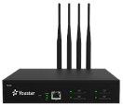
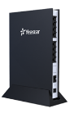


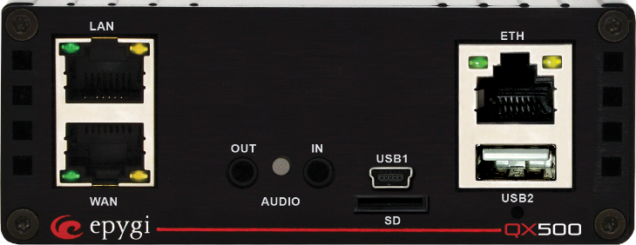


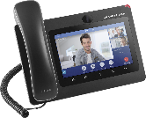
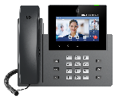
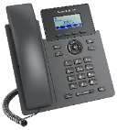
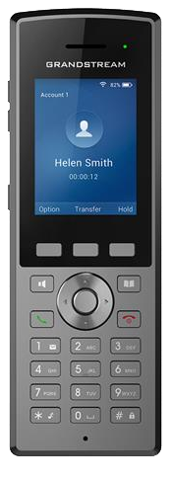
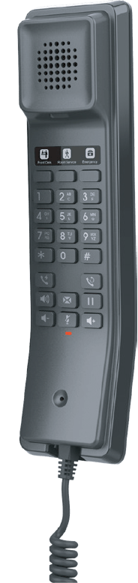
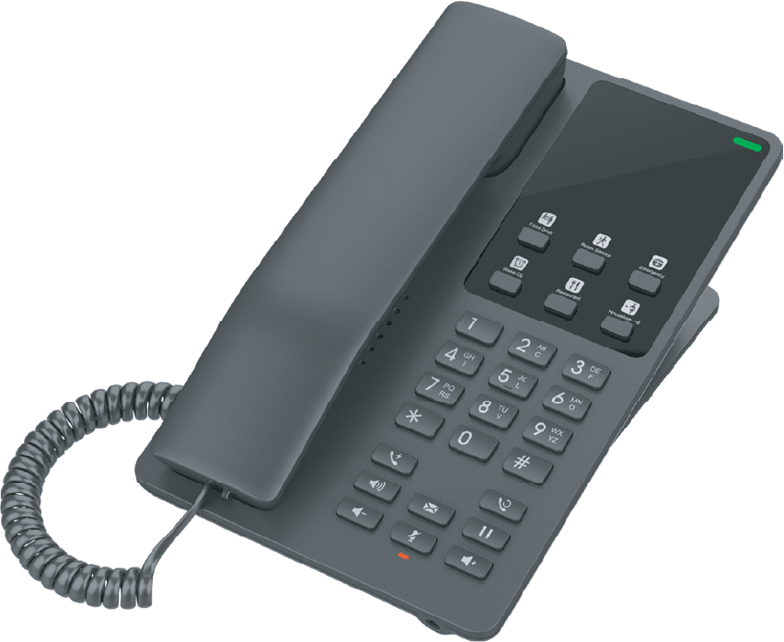

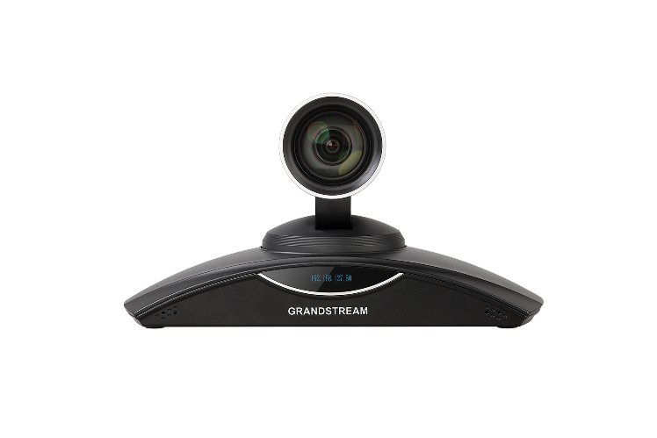







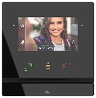



P
roduct Portfolio
Gateways & ATAs
E1/T1/J1 Ports
FXS & FXO Ports
Voice Conferencing
concurrent calls
Nat Traversal
Empowering Communication
Unified Communications
Upto 5000 Extension
Redundancy, voicemail, Recording
call center features
Integrated with 3 party products
Linkus App, Auto Dialer
Automatic Call Distribution
IP Video Telephony
16 SIP ac, Video Calling
Instant Messaging
Bring Your Own Device (BYOD)
Security and On-Premise Access
Employee Access
Huddle Rooms
IP Voice Telephony &
IP Hotel Phones
2 - 6 SIP accounts
Common-area phones
color screen, HD audio
Noise-shield technology
Enterprise-grade security
WiFi Cordless IP Phone
Bluetooth, wifi, BLF Keys
Audio/Video Conferencing
Runs on Android 9.0 operating system
Support for up to 300 participants and 120 video feeds per session; up to 10 simultaneous sessions
video and audio recording
1080p Full-HD video
Bluetooth, WiFi support
Built-in Mic/Speaker
PAN, TILT, ZOOM - camera
IPVideoTalk Meetings Platform
2011~
2013
IP Access Control & SW
Slimline design
Fastest mobile access
Bluetooth, IP55 and IK07
Controller and reader in one
Encrypted two-way communication
Perfect for the office or outdoor
2014
Smart Home
Automation
Smarter Home,
Sweeter Life,
Zigbee Hub. Intercom. Smart Home Control Panel in One
Answering Units
Luxury design with top materials
Smartphone as answering unit
Home automation integration
HD quality sound with ambient noise suppression
SIP Door Intercom
Intercom is a first access control device you will get in touch before you enter a building
It has to look very luxury in villas or MDUs
HD audio & video quality

Slide 5
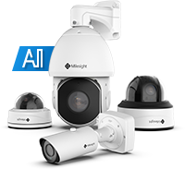




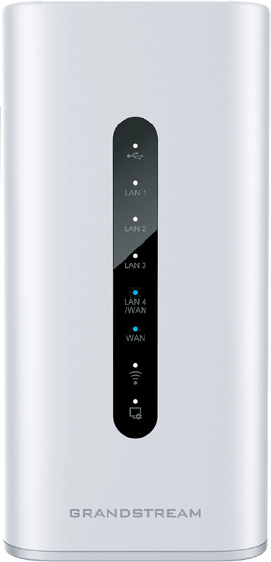

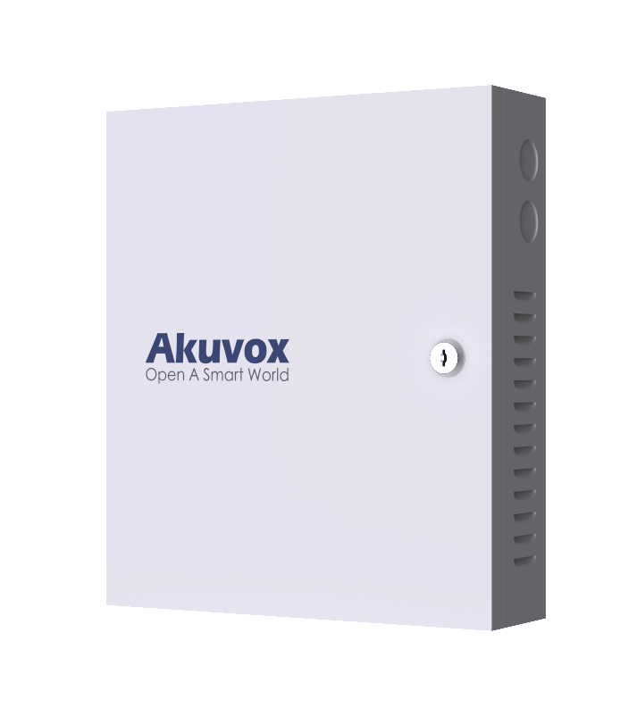
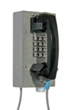
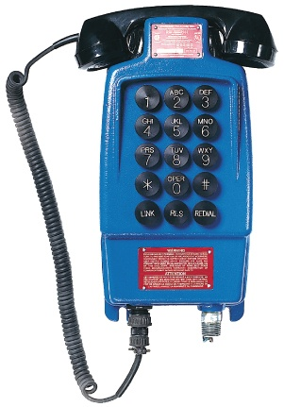
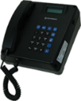


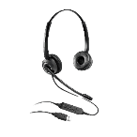

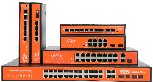
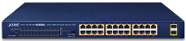


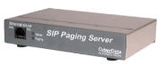
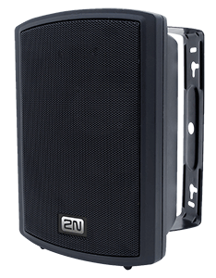
P
roduct Portfolio continue…
SIP Surveillance
Introduced H.265+ & Starlight & WDR
Debut of the unrivaled Mini PTZ Bullet Camera
New technologies: Auto Tracking, Advanced Heat Map and High-quality Deblur...
Release AI ANPR solution & Pro Bullet Plus (with 3D Radar Module)
Launch enterprise VMS
Empowering Communication
Wireless Access Points
& Routers
OFDMA technology
Range upto 300 meters
IP66-level weatherproof capability
GWN Cloud, GWN Manager, Embedded Controller
Elevator Management
Convenient for the residents
to get in and out without cards
to avoid residents
IP & Analog Industrial Phone
Hazardous & Non Hazardous
Water Tight, Weather/Water Resistant Phones
Food Industry Industrial Telephone
Correctional Institute Industrial Telephone
Call center solutions
Inbound/Outbound calls
Contact center on cloud
IVR, Auto dialer, Automatic Call Distributor
Hosted Call Center
2011~
2013
Personal Collaboration Devices
RJ9, USB & Wireless Headset
USB Webcam supports 1080p Full HD video
Designed for remote workers, contact centers and other busy environments.
Comfortable, cost effective, durable headset for Soho, VoIP, IP-phone
Light weight design, practical IP telephony sound quality
2014
Networking Switches
GREEN Networking, smart LCD
Port VLAN, Watch Dog
IP65, support 30-60W each port
Redundant Power
Industrial switches (-40℃～ 80℃)
Solar UPS/ outdoor Weather-Proof
Switches
250 m CCTV Long-Range switches
SIP Public Address System
SIP/Multicast/Informacast/Syn-App
Serverless IP paging solution
Communication with SIP devices
Integration with VMS via ONVIF
Loudest Sound in the market

Slide 6

Company Profile

Slide 7
Company Profile
1
Who We Are
CONTENTS
Yeastar at a Glance
2
What We Do
Yeastar Products & Solutions
3
Why Partner with Yeastar
Your Trusted Partner

Slide 8




Who We Are
The world’s leading provider of
Unified Communications solutions
Yeastar makes digital value easily accessible from ownership and adoption to daily usage and management by transforming how businesses connect and communicate. Yeastar has established itself as a leading provider of UC solutions with a strong ecosystem, a global network of channel partners, and over 650,000 customers worldwide.
Countries |  | Global Channels |  | Customers
120+ |  | 9,000+ |  | 650,000

Slide 9



Our Mission
We are committed to helping businesses remove barriers to a connected and collaborative digital workplace.
Through our easy-to-adopt, easy-to-use, and easy-to-manage solutions, we embark businesses, both small and large, on an easy, seamless and pleasant digital transformation journey.
Easy-to-adopt
Easy-to-use
Easy-to-manage

Slide 10
Yeastar Milestone
01 | Who We Are
2008
Yeastar MyPBX
Cater for users demand of transformation from analog to IP based
2013
Yeastar VoIP Gateway
Best VoIP Gateways for SMEs and Service Providers
2017
Yeastar Cloud PBX
Virtualized PBX, new type of business mode, future development
2021
Yeastar Central Management
A centralized platform for all Yeastar devices management & maintenance
2006
Yeastar was Founded
Entry into the VoIP industry with the release of our first product
2011
U-Series VoIP PBX
Handle the growing demand of heavy duty on VoIP communication
2016
S-Series VoIP PBX
Entry level phone system for small businesses
2020
P-Series Phone System
Converge voice, video, team chat, messaging, and more

Slide 11
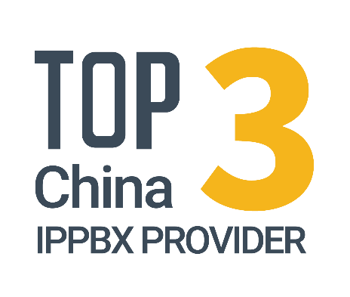

Yeastar Today
01 | Who We Are
Cloud PBX Growth Rate
Cloud Business Revenue Ratio
Continuous Revenue Growth
181%
40%
+30%
114%
95%
2022
2023
2024
Cloud
Other
2020
2021
2022
2023
2024
Global SME IP-PBX Leader
& Innovator
Our revenue keeps growing at an average of over 30% annual growth rate.

Slide 12


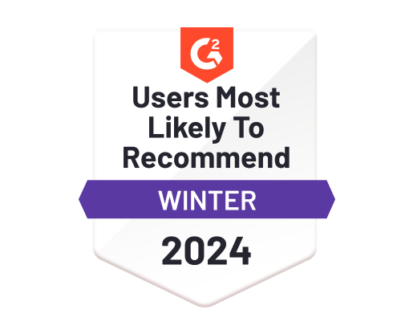



























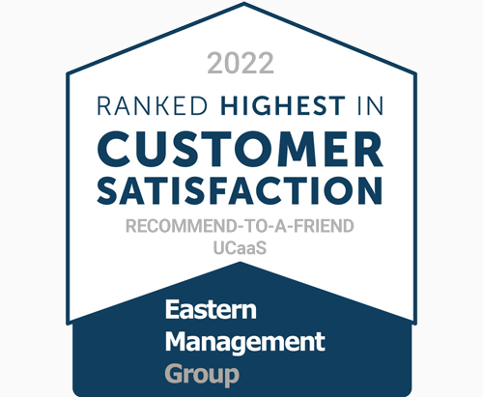
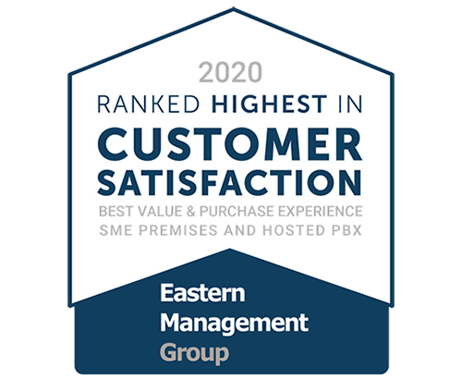











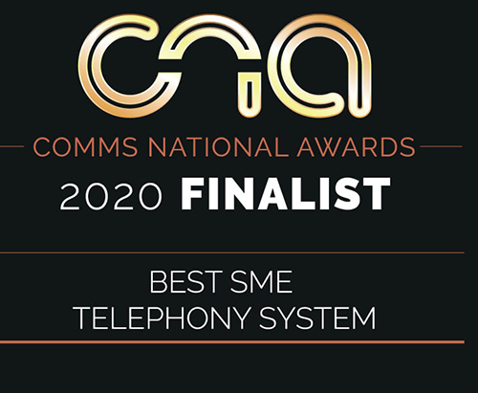
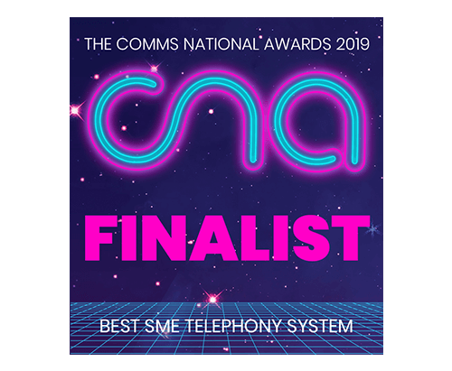




Yeastar Recognition
01 | Who We Are
Awards
Certification

Slide 13
Easy-first
Unified Communications
02 | What We Do
Our passion lies in creating values with the right technology
for partners, customers, and every business.

Slide 14





Easy-first
Unified
Communications
02 | What We Do
P-Series Phone System
Appliance Edition Cloud Edition Software Edition
Linkus UC Clients
Linkus Web Client Linkus Mobile Client Linkus Desktop Client
Easy to use
Easy to manage
Easy to integrate
Easy to adopt
More VoIP Products
S-Series VoIP PBX VoIP Gateways
Value Added Service
Remote Access Service Linkus Cloud Service Pro
Platform Tools for Partner
UCaaS Service Delivery and Management Remote Management

Slide 15
P-Series Phone System
Easy-first unified communications trusted by 650,000+ businesses

Slide 16

42% of companies have increased unified communications adoption.
Source: Unified Communication Market Outlook: 2023 – Allied Market Research
Worldwide PBX System Addressable Market by Seats
436 million
55% of businesses globally offer some capacity for remote work.
By 2028, it is predicted that 73% of business teams will have remote workers.
Source: Future Workforce Report, Upwork
Source: Eastern Management Group
Competitive Displacement Opportunities
Top Dissatisfaction Drivers
Customer Experience drives PBX churn
Businesses with PBXs installed more than two years are churn candidates
Source: Eastern Management Group
87% of remote employees say they feel more connected and involved with teams and projects when using video conferencing.
Source: Gigaom

Slide 17
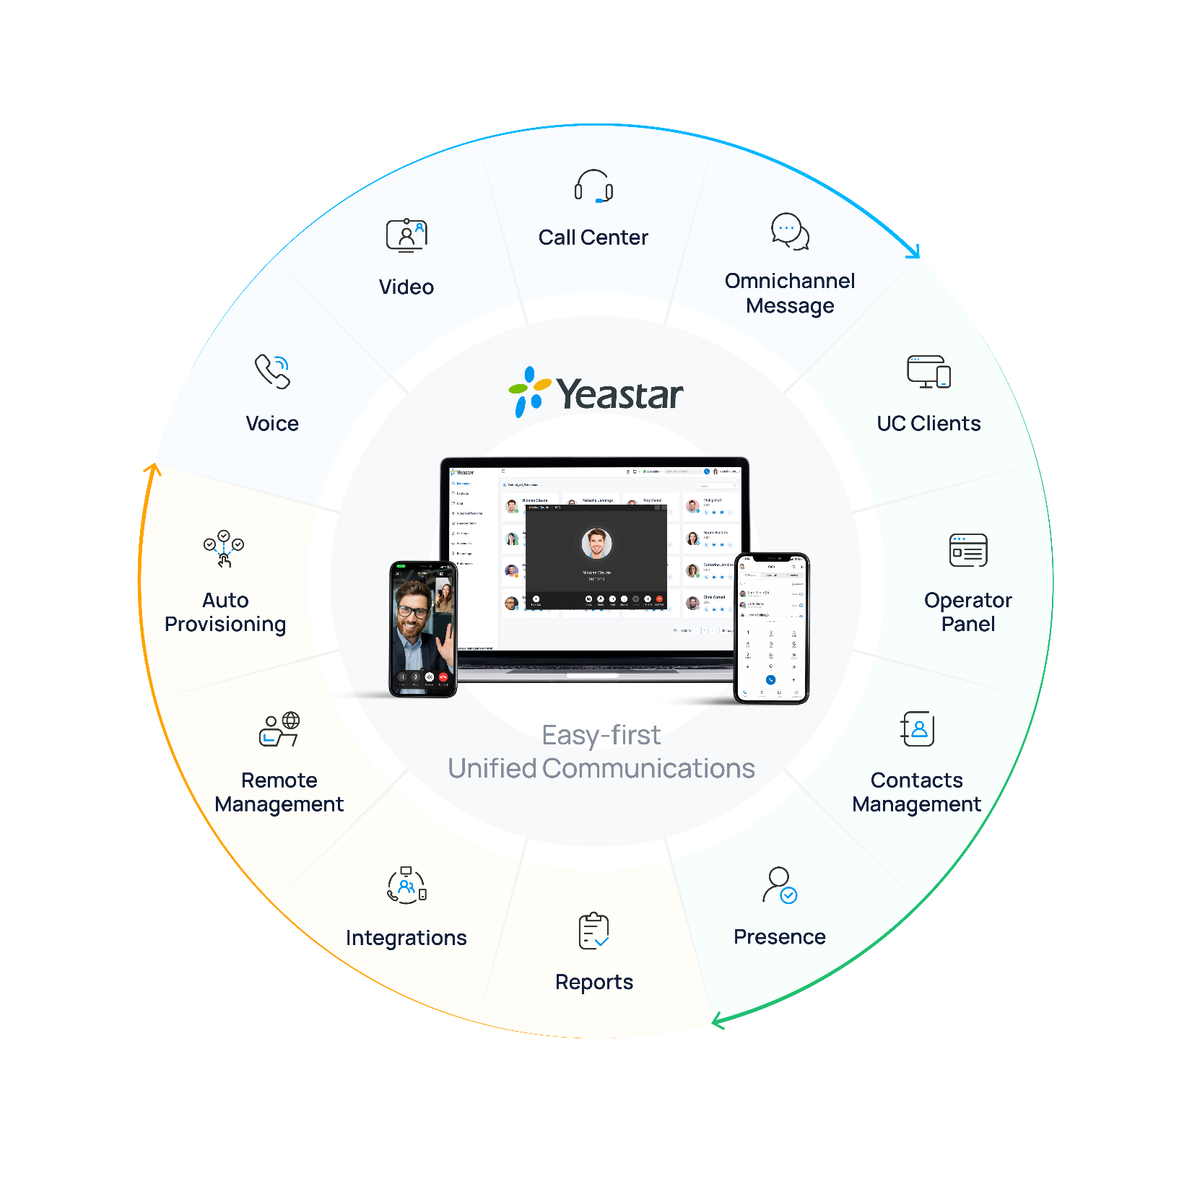
Go Boundless with
Easy-first
Unified Communications
With a focus on delivering easy-first unified communications, Yeastar P-Series Phone System helps you connect dispersed teams, level up customer experience, streamline IT, and boost employee efficiency at all levels with all you need in one simple system.

Slide 18
Easy, Flexible, Adaptable
Complete
Easy to use
Remote-friendly
Features for every use case. Deeply Integrated with Microsoft, popular CRMs, and more.
Set up in minutes. Manage and design call flows visually— no code, no IT hassle.
Remote enable your team to answer calls and help customers wherever they are.
Broadest endpoint supports
Trunk interoperability
World-class reliability
Pre-built auto provisioning for 500+ mainstream IP Phone models in the market.
Certified with 150+ ITSPs worldwide and support SIP / PSTN / ISDN / GSM trunks.
Guaranteed uptime and high availability solutions. Recognized security and privacy 3rd-party certifications.

Slide 19

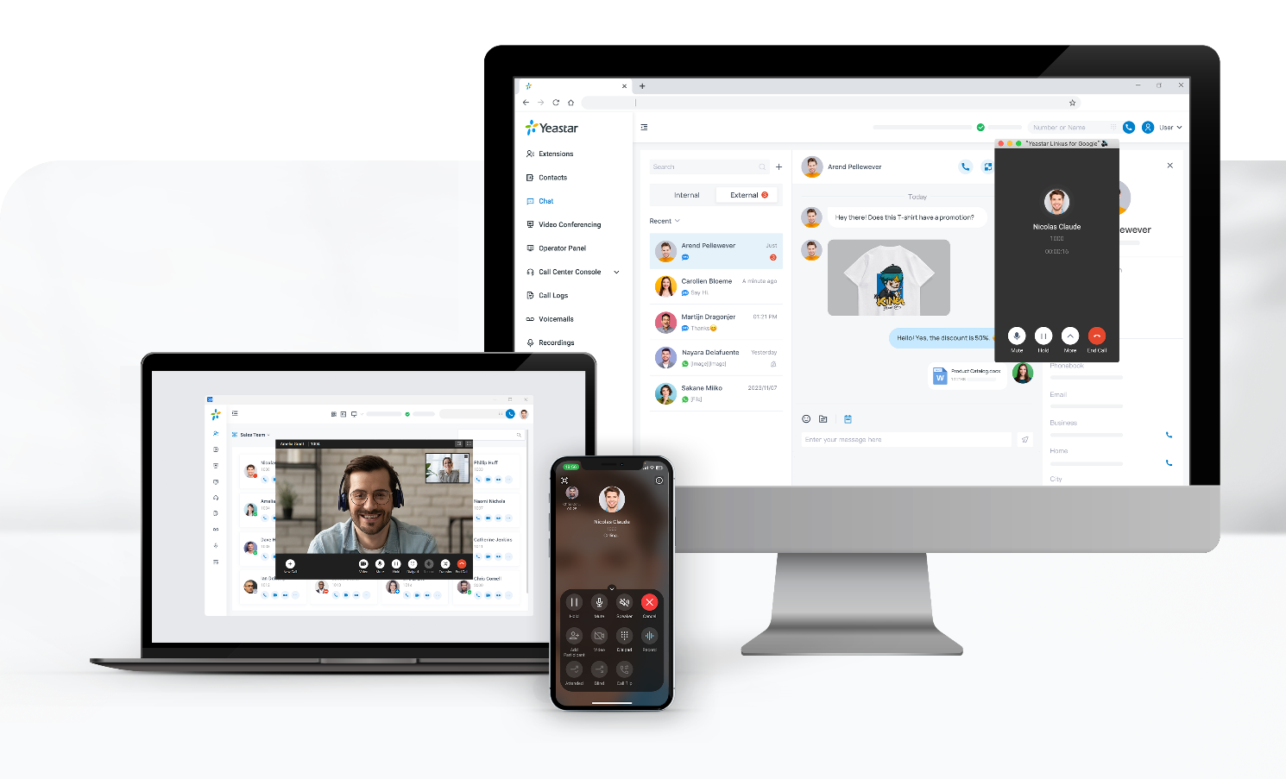







Ideal for Everyone
For Business Owners
Future-proof business with UCaaS + CCaaS in one platform
Omnichannel communications to boost customer engagement and sales
For Employees
One simple app for all-call, meet, message anywhere, on any device
Work more efficiently with integrations & automation
For IT and System Admins
Simplify setup, admin, and IT management
Automate IP phone provisioning
Bring your own number and SIP trunks
Protect, control and manage access easily
Maximize uptime in case of unforeseen event
Visually build and deploy complex call routing logic in minutes
Easy to use, manage, integrate, grow
+

Slide 20
Improve Employee Efficiency
From must-have to nice-to-have, Yeastar P-Series include 100+ enterprise-level features as standard, with small business cost.

Slide 21
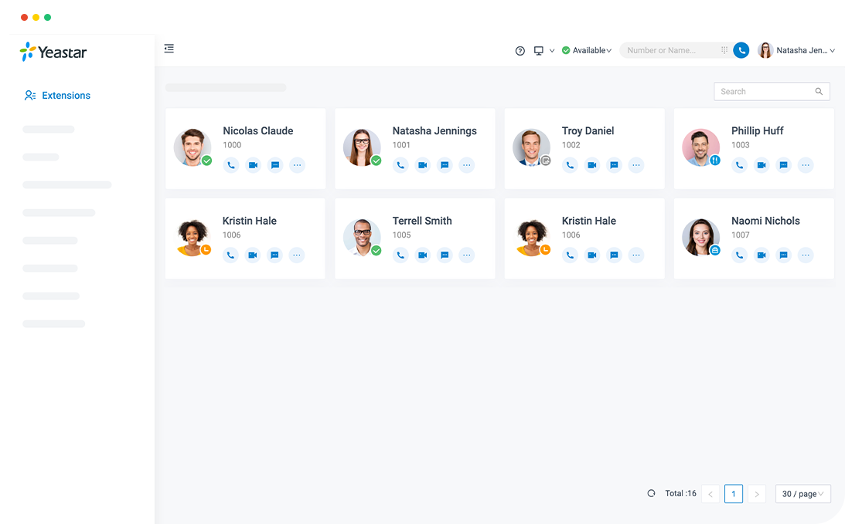
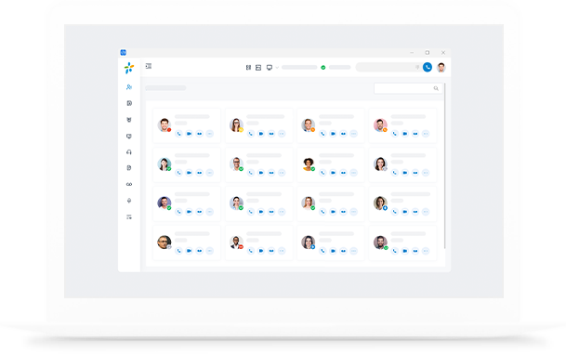
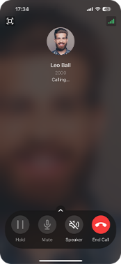

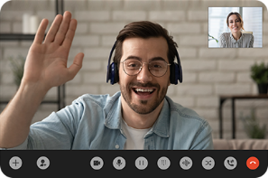

Linkus UC Clients
Stay Connected Anywhere Anytime
All office extension features
Handle calls, chat with teams, audio/ video conference, message with customers, listen to call recordings, check voicemails, send and receive faxes directly, and more, all in one simple app.
All contacts in one place
With PBX-native contact management, intuitive phonebooks, and cross-system contacts synchronization, manage all your contacts in one place.
Easily switch devices
Use the app on your web, mobile, or desktop and flip calls seamlessly between devices. Web/Mobile/Desktop Clients Lightweight Google Chrome Extension

Slide 22
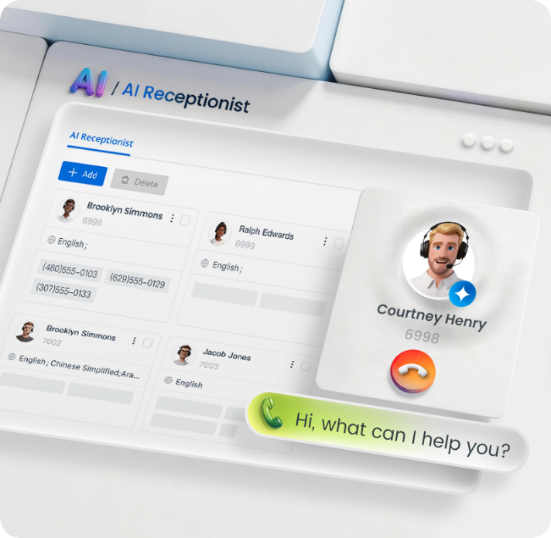
AI Receptionist
Never miss a call or a customer. Yeastar AI Receptionist answers, understands, and routes every inbound call, automatically, around the clock
24/7 Call Answering
Handles calls outside business hours, during peak traffic, or when agents are unavailable
Knowledge-Driven Interactions
Answers caller questions in real time by referencing your uploaded documents or indexed website content
Intent-Based Call Routing
Transfers calls to the right extension or department based on caller intent
Performance Insights
Track every AI Receptionist call via CDR and Call Reports

Slide 23
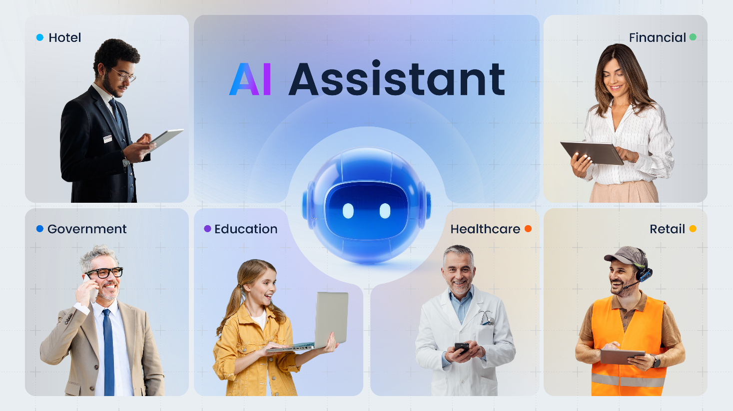
AI Receptionist
Intelligent Call Handling
  Humanized Interaction
  Intention Recognize
  Knowledge Base
  Reporting

Slide 24
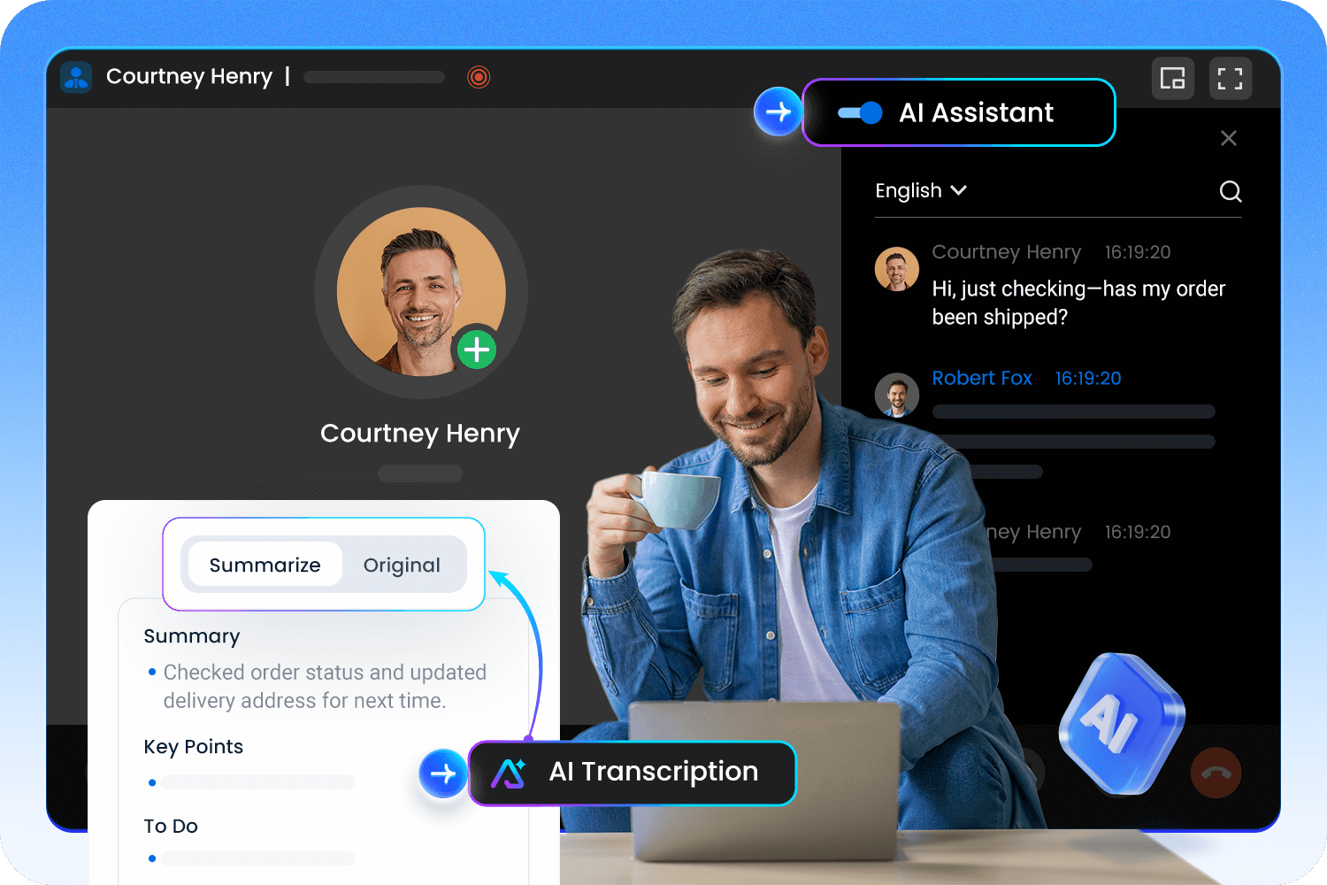
Call Transcription & AI Summary
Unlock Insights from Every Conversation: Turn calls into text and actionable summaries
Real-time Transcription
Live speech-to-text for instant conversation translation.
AI-generated Summaries
Instant key points, notes, and actions for every call.
Searchable Intelligence
Search & review information with call log.

Slide 25
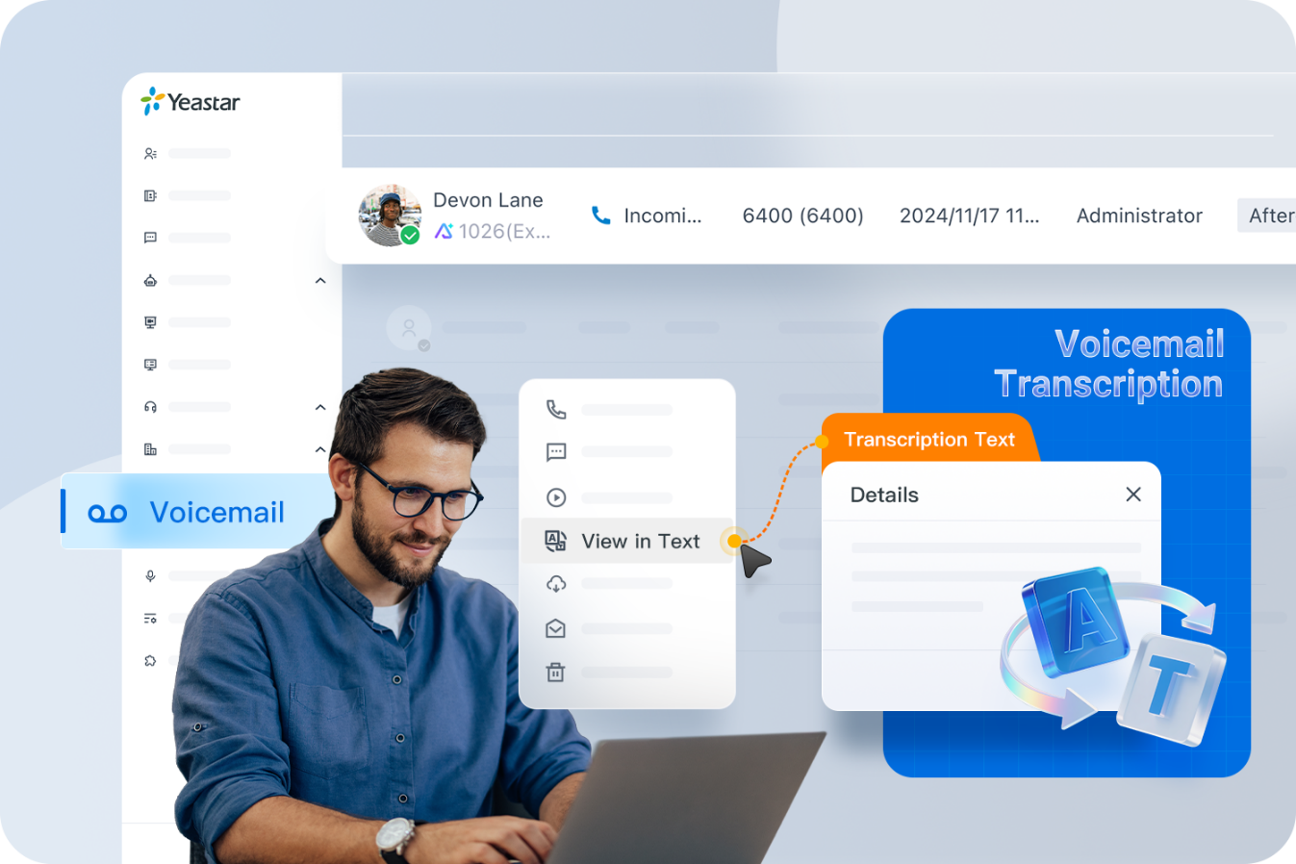
AI Voicemail Transcription
Read Messages at a Glance: Convert voicemails to readable text instantly
AI-Powered Transcription
Accurately transcribe voicemails using STT
Multi-Platform Delivery
Receive transcriptions via Linkus UC Clients (web/desktop/mobile) or email directly
Time-Saving Efficiency
Scan messages in seconds — no listening required

Slide 26

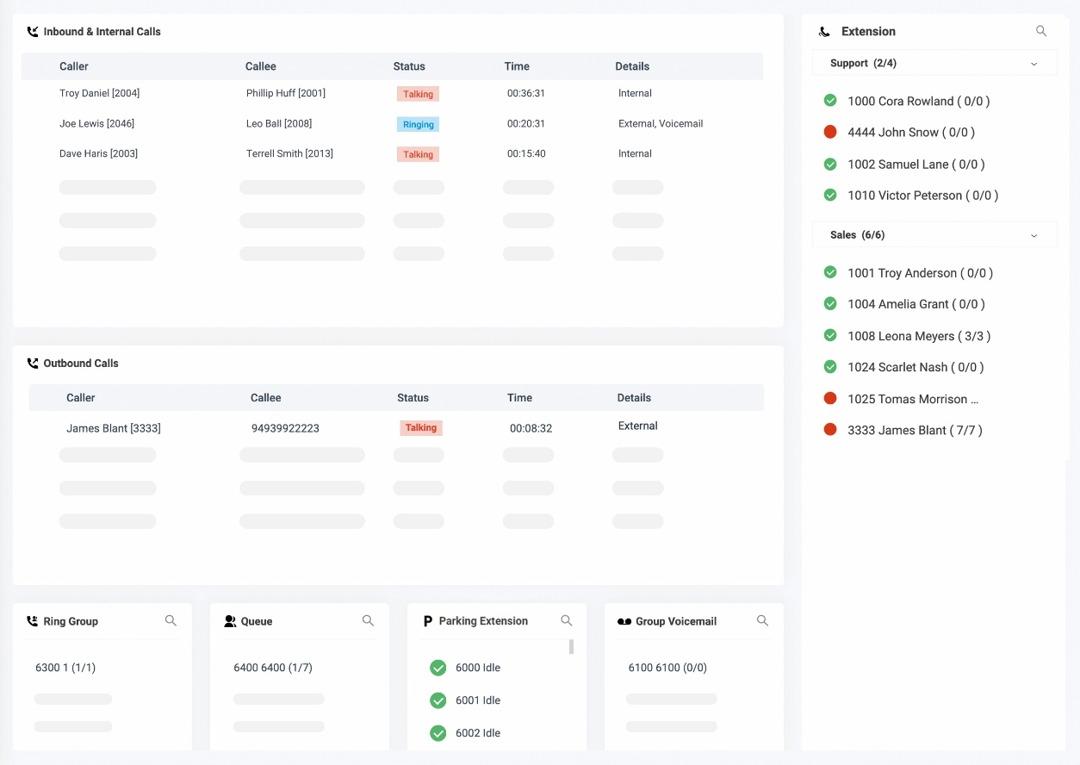

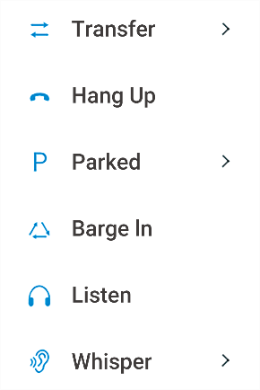




Easy Call Control
Your visual, intuitive tools to handle daily calls with ease
Automatic Routing
Inbound/outbound based on trunk, numbers, time condition, user presence, etc.
All Features
IVR, call transfer, hold, mute, park, pickup, merge, monitor, record, and many more.
Intuitive Operator Panel
Web panel to manage calls based on the availability of all call destinations
Desk Phone Control (CTI)
Connect Linkus with your IP Phone to control calls on computer.

Slide 27
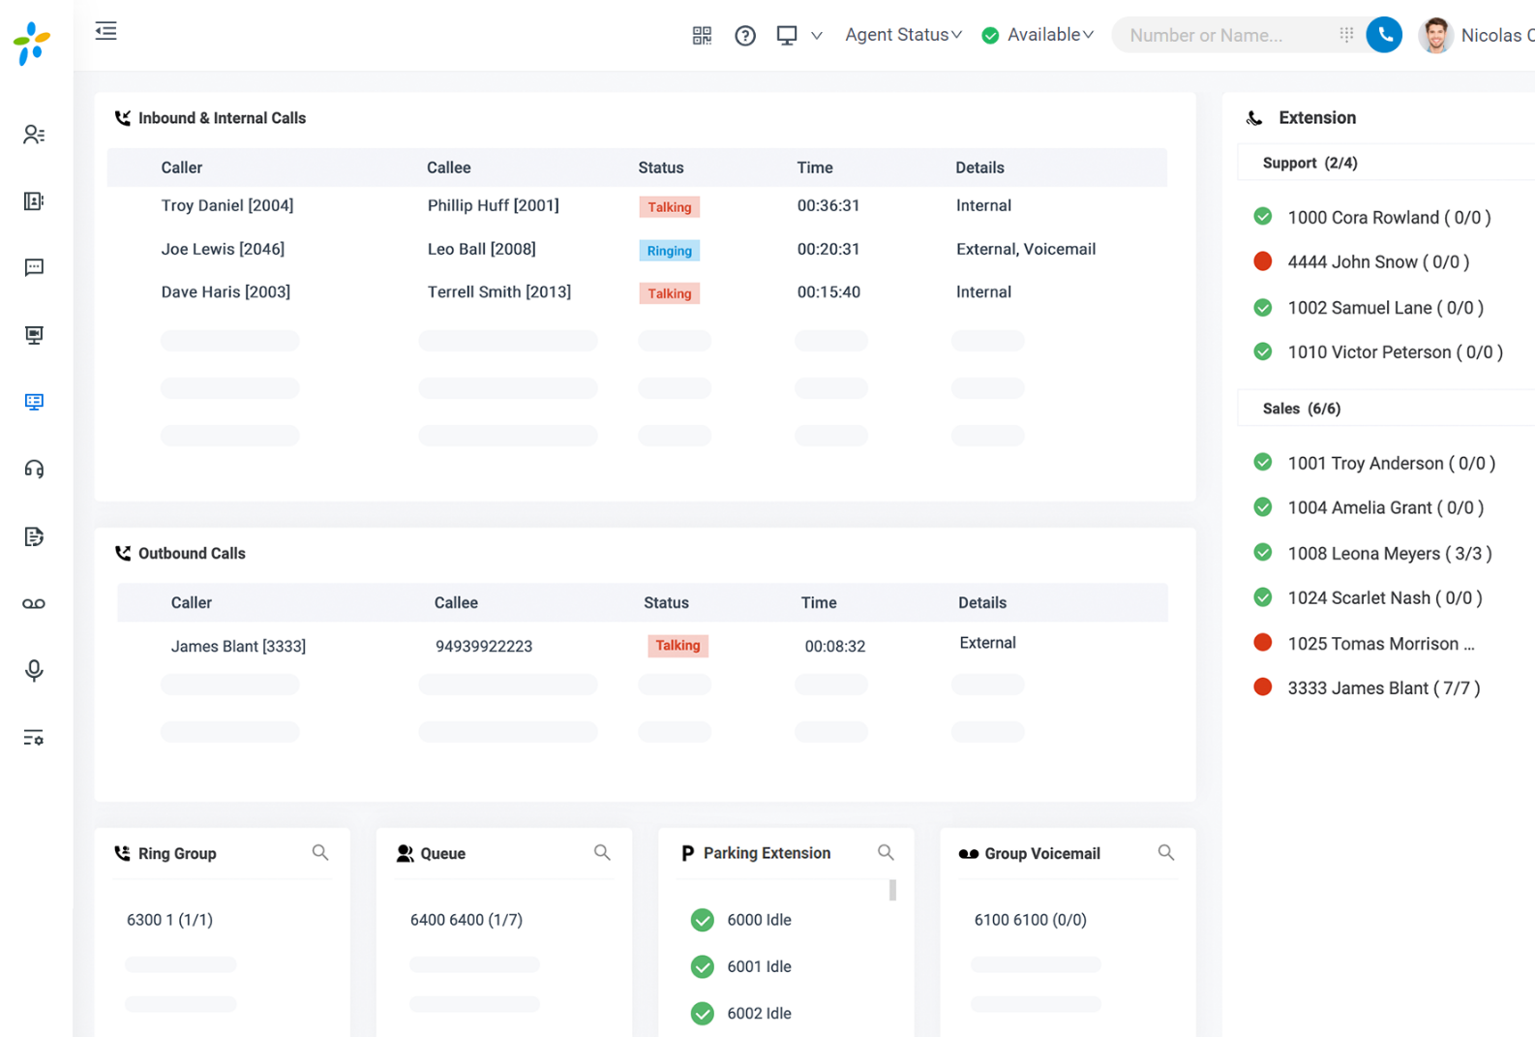

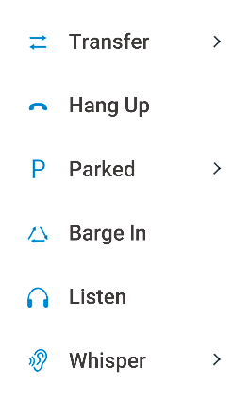




Call Operator Panel
The web-based operator panel gives you a graphical, holistic view and complete control of the call activities in your company in real-time.
Inbound/outbound call activities in one view
Real-time state of available call destinations
Drag-and-drop call distribution
Advanced call control with clicks
Ideal for companies that have receptionist and supervision requirements to achieve next-level call management efficiency

Slide 28
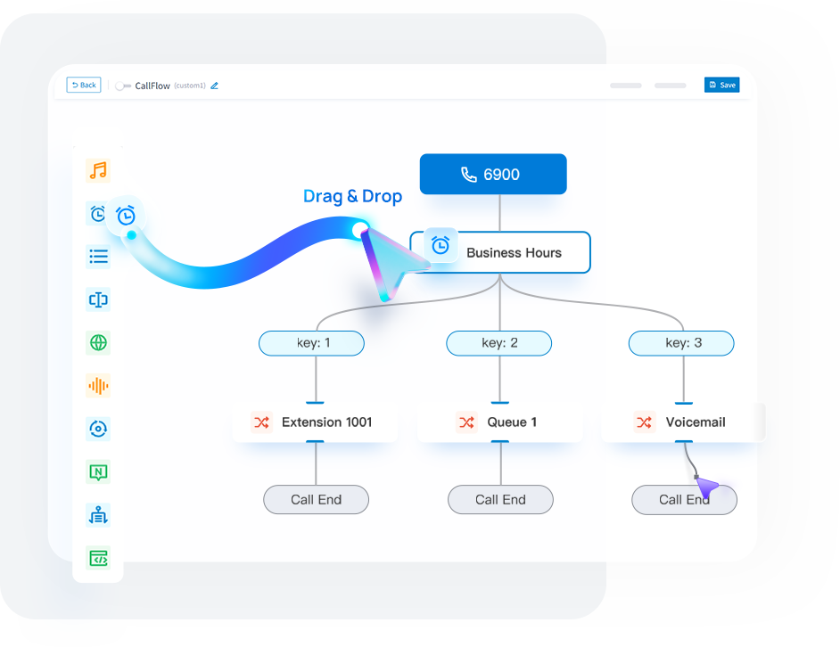
Call Flow Designer (CFD)
Easily build call flows using a simple drag-and-drop interface
Drag-and-Drop Builder
Intuitive interface for effortless call flow design
Smart Routing Rules
Route calls by time, caller input, language, CRM data, database authentication and more
AI-Powered Interactions
Use Text-to-Speech feature to create dynamic, lifelike voice prompts
Pre-Built Templates
Launch professional call flows in minutes

Slide 29
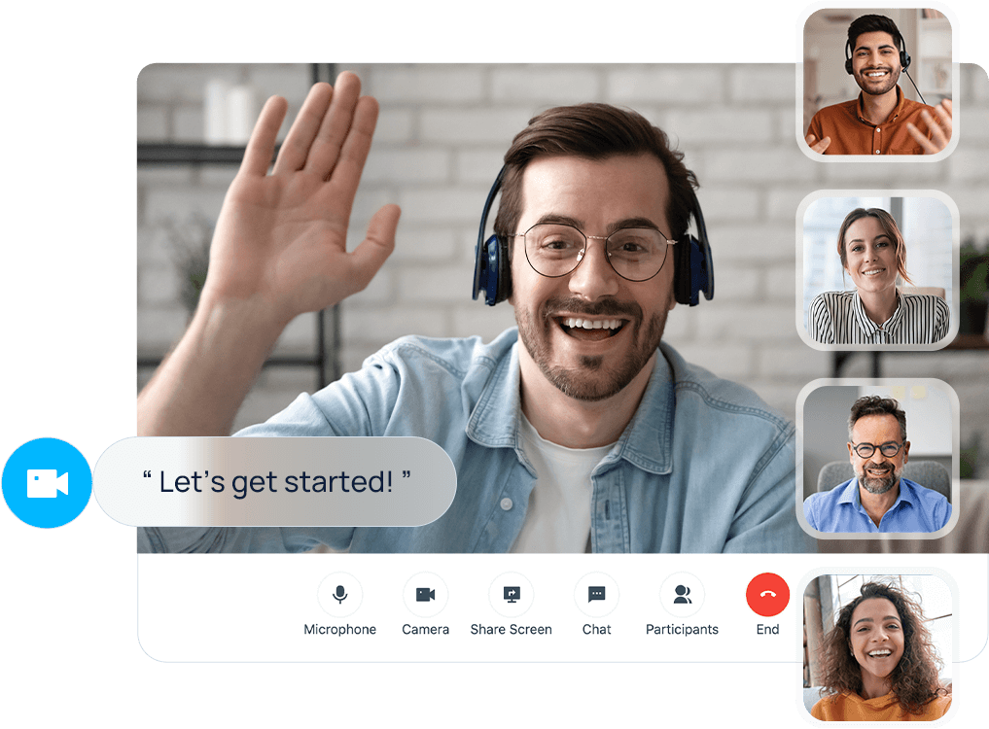
Easy Video Communications
Meet your teams and customers instantly and securely, from anywhere
Integrated Web Video Conferencing
Start instantly with HD audio and video, screen sharing, in-meeting chat, and complete meeting controls.
1:1 Video Calls
Initial a new or switch an audio call to video call with a single tap, right from your mobile (iOS & Android) or web browsers.

Slide 30
Other Collaboration & Productivity Features
Team Chat
Contacts Management
Chat with your colleagues 1-to-1 or in group and continue the conversations from and devices.
Manage personal or shared external contacts. Create native one or sync from CRM or database.
File Sharing
Function Keys
Share files, documents, images, etc. during chats with colleagues for easier collaboration.
Set up feature shortcuts to speed dial, intercom, BLF monitoring, and more.
Presence
Daily Apps Integration
Let your colleagues know if you are available at a glance with colored presence indicators.
Integrate the Microsoft Teams, Outlook, popular CRMs, and more.

Slide 31
Boost Customer Engagement & Sales
Let your customer contact your company on the communication channel of their choice, and empower your call agents, supports, and sales to work smarter.

Slide 32


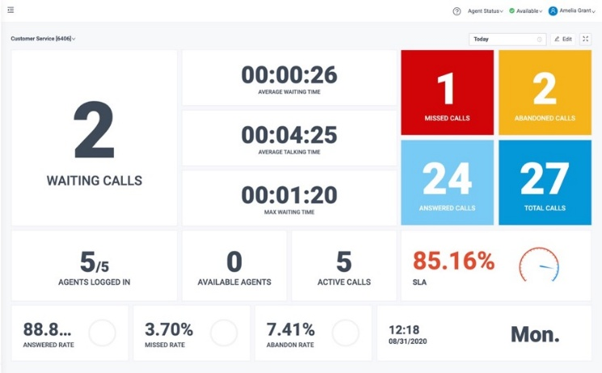
Built in Call Center Solution
Benefits
Allow agents to work anywhere
Handle volume & resolve swiftly
Empowered agents and managers
Additional omnichannel support
Reduce IT dependency
Compliant with data privacy and security standards: GDPR, PCI, ISO 27001, etc.
Deliver exceptional customer services with all the agent and supervisor tools that drive faster call resolution and boost agent productivity

Slide 33
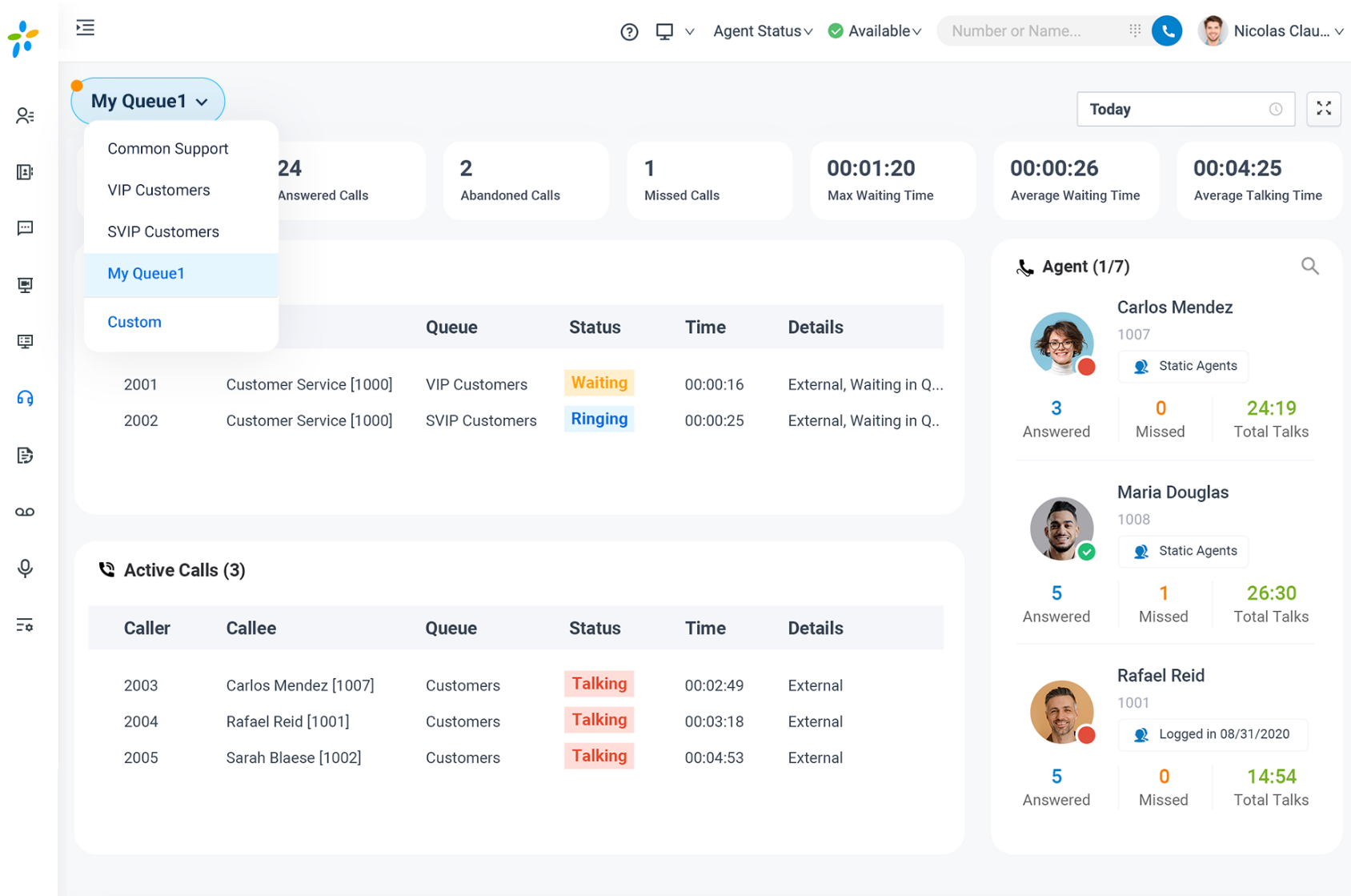
Operational Queue Panel
Handle your daily call center operations efficiently through a single interface
Manage agent status: login/out, pause/unpause
Handle queued calls: drag-and-drop distribute & transfer
Live agent coaching: click to listen-in, whisper, barge-in monitor
Track & label missed call processing results
Display real-time active/waiting queued call list
Display Real-time queue performance metrics at individual, group or aggregated level

Slide 34
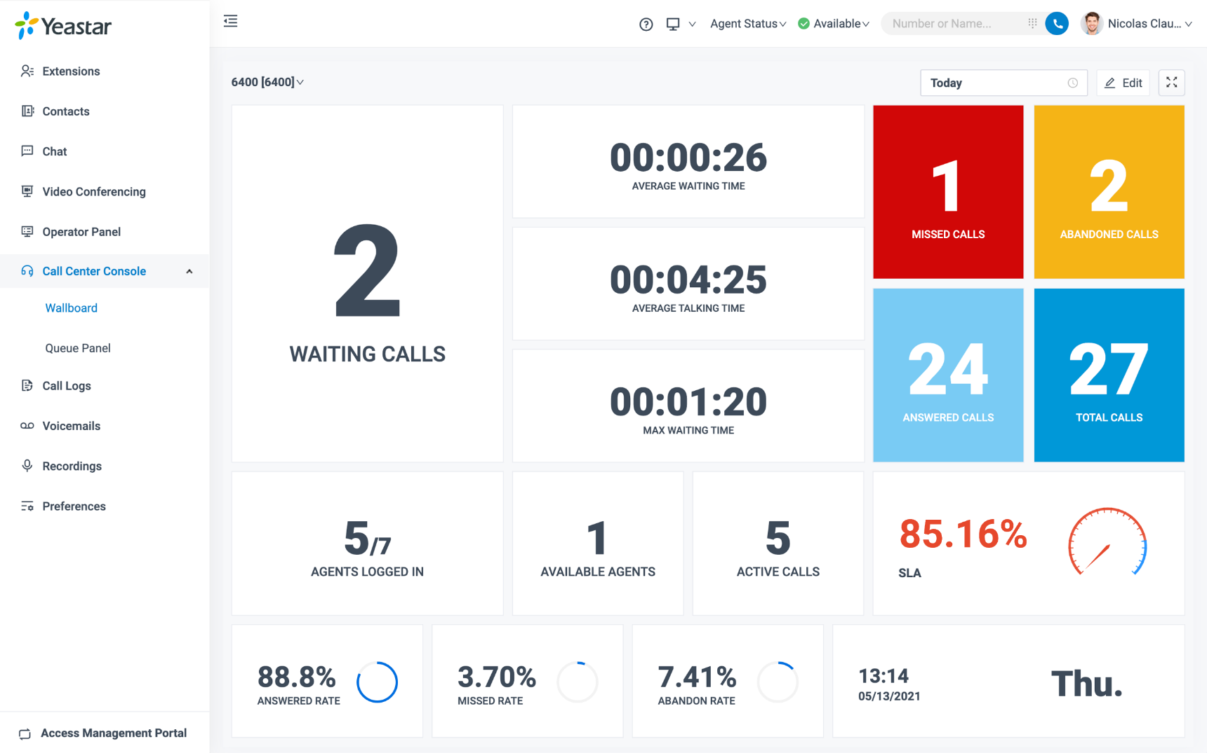
Wallboard
Allow your manager and agents see call stats & KPI performance at a glance anytime
Track real-time stats of one or multiple queues
17 key performance metrics including SLA, Missed Rate, Waiting Call Number, etc.
Two customizable styles of view: widget-based view & list view
Automatic notification on reaching SLA threshold
Easily spot the emerging trend at a glance

Slide 35
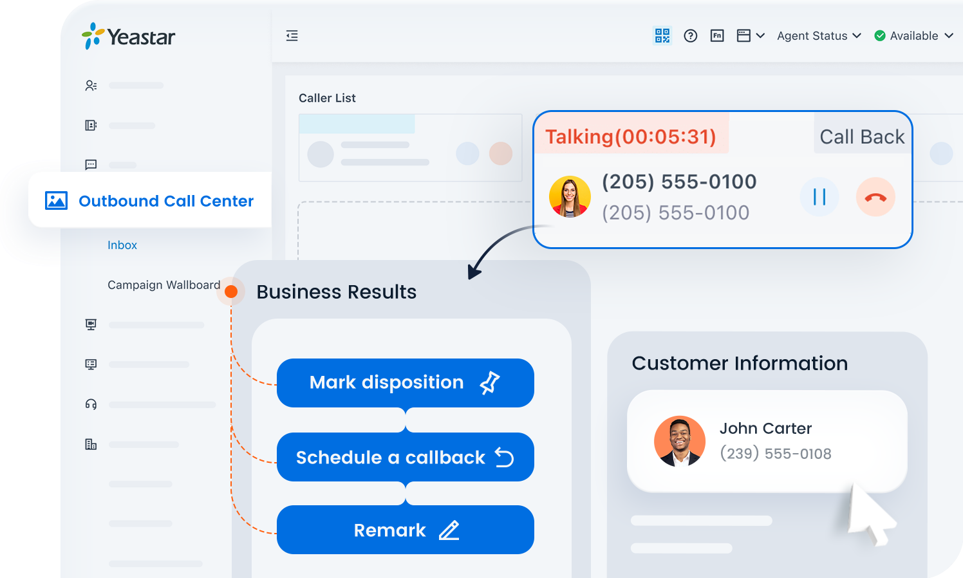
Outbound Call Center Solution
Supercharge your proactive outreach efforts with advanced dialing automation and easy campaign management.
Auto Dialers (Progressive Dialer, Power Dialer, Agentless Dialer)
Outbound Campaign Management
Campaign Wallboard
Agent-based Call Inbox
DNC Lists & Attempt Control
And more..

Slide 36
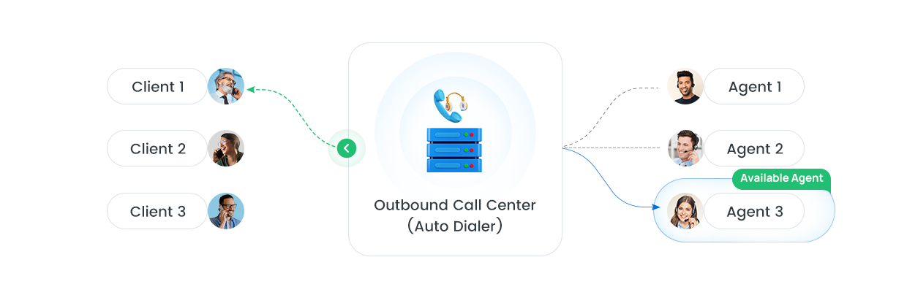
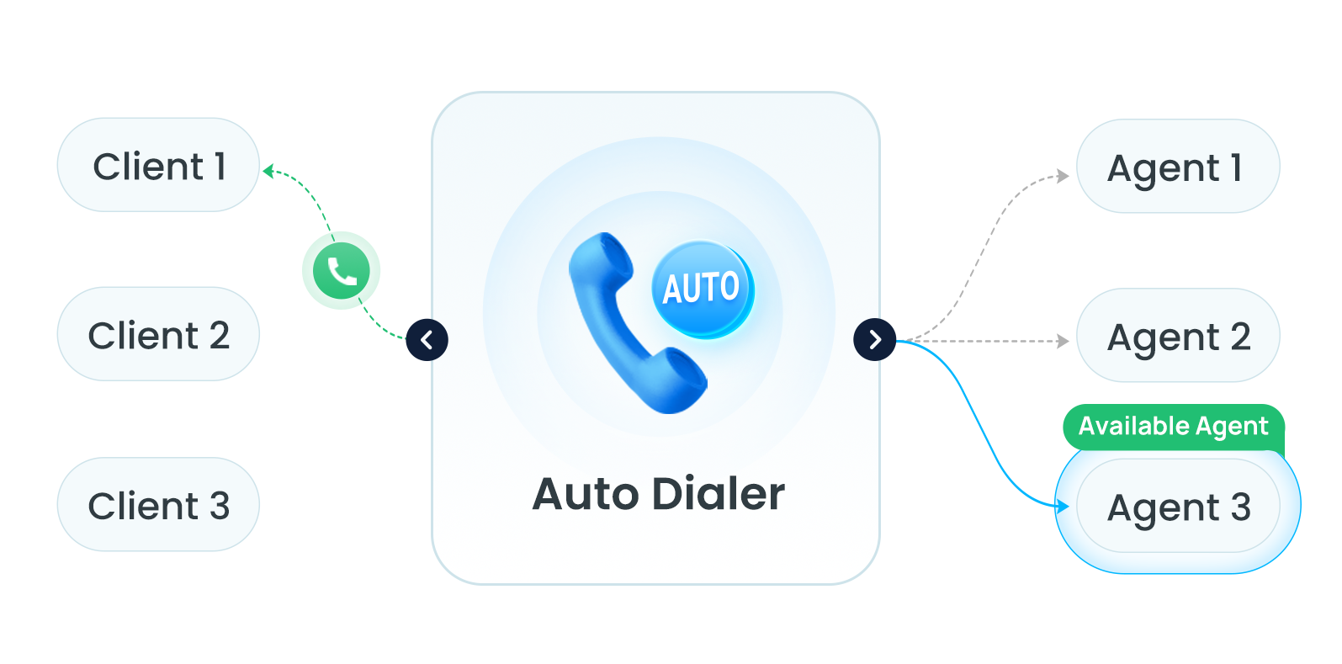
Built-in Auto Dialers
Automate calls, reduce workload, and maximize engagement with 3 auto dialer modes for your campaign needs.
Progressive Dialer
Dial one-on-one for high-quality lead-agent connections.
Power Dialer
Adjust dialing rates to maximize calls and minimize drop-offs.
Agentless Dialer
Deliver messages or telemarketing without live agents, enabling rapid outreach.

Slide 37

Real-time Outbound Campaign Wallboard
Discover up-to-the-minute outbound campaign performance metrics, detailed dialing logs, and call disposition summary — all from a single, intuitive wallboard.
Track outbound campaign statistics
Monitor live KPIs: connect rate, abandon rate, and more
Visualize dial results & dispositions summary
Filter and search dialing logs in seconds
Track queue agents' status in one place

Slide 38

Agent-based Call Inbox
Streamline operations with a unified operation hub for agents, combining complete view of all assigned campaign calls, contact details, and related operations in one place.
View real-time active/waiting calls
Answer, hang up, or manage assigned calls
Access detailed customer information
Label call outcomes and add remarks
Schedule an automatic callback

Slide 39
All-inclusive Call Center Features
Self-service Interactive Voice Response (IVR) Multi-level Multi-lingual Time condition-based Custom Greetings & Voice Prompts Visual Call Flow Designer* Quality Assurance PCI-compliant Call Recording Call Monitor, Whisper, Barge-in Post Call Surveys* | Call Queue Treatment Automatic Call Distribution (ACD)* Skill-based Routing* Priority Queue & Acceleration Automatic Queue Callback* Queue Ring Strategies Liner (Fixed Order) Ring All (Simultaneous) Rrmemory (Rotary) Fewest Answered Least Recent Random Music on Hold Custom Voice Prompts Queue Position Announcement Estimated Wait Time Announcement | Agent Experience Web-based UX Dynamic & Statistic Agents Queue Panel* Missed Call Disposition* Screenpop Call Note* Contact Record Display* Linkus UC Clients Browser-based Windows, MacOS iOS & Android Computer Telephony Integration Voicemail Announcement* | Outbound Call Capabilities Auto Dialer Progressive Dialer Power Dialer Agentless Dialer Outbound Campaign Call Inbox Assigned Outbound Call List Customer Details Call Disposition Scheduled Callback Outbound Campaign Wallboard Performance Metric Data Dialing Logs Dial Result Summary Campaign Management Campaign General Settings Outbound Queue Management Local Presence DOD
* These features are available on Enterprise Plan or above.

Slide 40
All-inclusive Call Center Features
Team Collaboration Agent Presence Status Call Transfer (Cold/Warm) Three-way Calling 1:1 and Team Chat* Group Chat in Message Queue File Sharing* | Dashboard & Reporting Wallboard & Real-time Analytics* SLA Monitoring & Notifications* Real-time and historical reports* IVR Reports Agent Performance Report Agent Call Summary Reports Agent Activity Reports Queue Performance Report Queue Callback Reports Queue Activities Reports Satisfaction Survey Reports Unreturned Missed Call Report | Omnichannel Messaging Live Chat* SMS Integration* Facebook & WhatsApp Integration* Bulk Messaging (SMS & WhatsApp) * Integrations CRM Integration* Helpdesk Integration* Database Integration* Open APIs Linkus SDKs*
* These features are available on Enterprise Plan or above.

Slide 41







Omnichannel Messaging
Process all inbound inquiries in one place and drive outbound growth
Handle all messaging channels in one inbox
Collaborate as a group in message queue
Match contacts & track the history of every chats
Engage conversations with rich media support
Power outreach with robust SMS & WhatsApp bulk messaging
Live Chat
Facebook
SMS
WhatsApp

Slide 42

Live Chat
Provide efficient and real-time support to your website visitors. Answer questions, nurture leads, and solve problems instantly.
Click to chat and call (audio & video)
Follow your visitors’ browser language
Embeddable on any website or CMS platforms
Optional pre-chat form to capture leads
Custom styling and messages to fit your brand
Easy to configure with real-time preview

Slide 43





































VoIP Ecosystem & Integration
Take advantage of our ready-made integrations and an open ecosystem that works for every business needs.
IP Phone Auto Provisioning
CRM / Helpdesk / Database Integration
LDAP
500+ Models
14+ Brands
Collaboration & User Management
SIP Trunk Interoperability
Hotel PMS Integration & Middleware
150+ ITSPs
Headset Integration
File Remote Archiving
FTP
SFTP

Slide 44











IP Phone Auto Provisioning
Perfect interoperability with 500+ IP phones. Support auto provisioning to bulk configure IP phones.
In the office
PnP
DHCP
Remote
RPS
RPS FQDN

Slide 45

Headset Integration
Answer, reject, mute, and control calls with your headset
Support Linkus Web Client
Support Yeastar Linkus for Google
Plug and play to connect your headset
Recommended Vendor: Jabra, Yealink, EPOS, Poly
Compatible with any WebHID compliant headset

Slide 46





Intercom Telephony Integrations
Reception / Security Center
Indoor / Outdoor Broadcast
Outdoor Access
Network Server Room
Video Console IP Phone
Hikvision Indoor Intercom Station
Hikvision Intercom Door Station
Yeastar PBX System
Hikvision Intercom
Indoor Station
Network
Hikvision SIP Speaker
Ticket Vending Machine Intercom
Hikvision SIP Speaker
Yeastar Linkus Clients
IP Phone
Analog Phone
Adapter
Analog Speaker
Analog Speaker
Parking Lot
Office

Slide 47

Door Phone Video Preview & Auto Preview
Know who’s visiting before answering the call
Enhance security and provide more convenience
Support preview from: Linkus Web Client, Linkus Desktop Client, and Google Chrome Extension.
Supported door phone brand: Fanvil

Slide 48


CRM Integration
Yeastar PBX seamlessly integrates with leading CRM platforms to enhance business efficiency. We offer out-of-the-box compatibility with ready-made CRMs, as well as custom integration for your local CRMs.
Click to call
Call Popup
Contact Synchronization
Call Journaling
Create New Contact for Unknown Caller
Custom
+

Slide 49

Integrate PBX with Microsoft Dynamics 365
The Linkus plugin integrates advanced telephony functionality natively into Microsoft Dynamics 365
Linkus for Dynamics 365 Plugin
Caller ID to Contact Name
Real-time Contact Sync
Contextual Call Popups
One-click Contact Creation
Native Click-to-Call
Call Activity Logging
Call Recording Access

Slide 50

Helpdesk Integration
Close support tickets faster with call automation for your helpdesk system.
Integration Template to Link Other Helpdesk
Sync Helpdesk Contacts
Create New Contacts
Create New Ticket
Call Journaling
Click to call
Call Pop-up
Custom
+

Slide 51

Microsoft SQL Integration
Sync user details from SQL database for easier contact management
Real-time caller lookup in SQL database
Sync contacts from MS SQL to PBX phonebook
Route calls based on contact-phonebook match.

Slide 52





Microsoft 365 Integrations
Microsoft Entra ID
(formerly Azure Active Directory)
Teams Outlook
User Authentication and Access Control
Make Calls
View Call Logs
Access Voicemails
Access Recording
Click-to-call
Call Popup
Automatic Contact Creation
Call Journal
Directory Users
Linkus Web Client
Linkus Desktop Client
Yeastar PBX Server
One-way Synchronization of Users and User Groups
Make Calls Directly from Teams/Outlook via PBX

Slide 53


Microsoft Teams Integration
Free embedded App with no extra charges
Seamless calling experience from Linkus Web / Desktop Client
Keep your original Teams using habits
A fully-featured PBX within your Teams app
Hassle-free installation and maintenance
Start from Microsoft 365 Business Basic
Don’t need a Teams calling license

Slide 54



Outlook Integration Add-in
Click to call from Outlook contact list or mailbox
Outlook contacts incoming calls automatically popup
Call Journaling saved to Outlook contacts’ notes
Create New Contact for Unknown Caller
Outlook Integration Notes:
Outlook PC Edition: Outlook 2016 and above
Windows Edition: Win10/Win11

Slide 55

Integrate PBX with Microsoft Directory Service
Microsoft Entra ID (formerly Azure Active Directory) & Windows Active Directory (AD)
Sync users, contacts, and Teams status across the platforms and allows users to log into their Linkus UC Clients by Microsoft account.
User Synchronization
Single Sign-on (SSO)
Group Synchronization
Personal & Shared Mailbox Contacts Synchronization
Synchronize Teams Status to Extension Presence

Slide 56

File Remote Archiving
Off-load your call recordings and system backup files to Amazon S3, Google Storage, or an FTP/SFTP server
Free up PBX local storage space
Efficiently manage large volumes of recordings & system backups files
Enable long-term file storage, avoiding the pitfall of auto-cleanup when your PBX storage limit is reached
Enable external backups of system files
Off-load files to cheaper remote storage, making your PBX setup more cost-effective

Slide 57

API Interfaces on P-Series Phone System
Supported Interfaces:
PBX Configuration
Call Control
UACSTA Call Control
Event Notification

Slide 58

P-Series Linkus SDK
Integrate voice calling to any application easily
  Web/Browser SDK
  Mobile/Pad SDKs: Android, iOS
  Desktop SDKs: Windows, MacOS
Feature-rich voice experience within your app
  HD Calling, Call Control, Call Recording, Call History, Notifications, and more features.
Rich, programmable code samples and UI
Secure authentication with tokens
Faster and standardized development

Slide 59




Remote Access Solution
Connect your remote workers, offices, and SIP devices to your central office PBX at ease, in a highly secure manner.
Remote SIP Service
SIP Access
Remote Access Service
Linkus Access Web Access LDAP Access More
Remote PBX
Remote IP Phone
Linkus UC Clients
Remote Gateway
Remote Locations
Central Office PBX
Remote Locations

Slide 60
Multi-layer Security
Endpoint Security
Extension Registration
Account Lockout
Registration Credentials
Concurrent Registration
User Agent
IP Address
Remote Registration
Extension Login
Account Lockout
Single Sign-on
Two-factor Authentication
QR Code / Link Login
Password
User Role
Outbound Call Security
Outbound Call Security
Phone Number
Call Frequency
Concurrent Calls
Call Duration
Outbound Route
PIN Code
Time Condition
Country / Region
Endpoint Security
Network Security
Contingency Plan
Network Security
Avoid Port Forwarding
Global Anti-hacking IP Blocklist
Country / Region
Static Defense
Auto Defense
System Security
Contingency Plan
Event Notification and Logging
Backup
System Security
Upgrade Firmware
Disable SSH

Slide 61

Two-factor Authentication
Add an extra layer of support of security
Authentication options include Authenticator App on Smartphone and Email Authentications
Save trusted devices that can skip the 2FA
Works on P-Series Management Portal login, Linkus login, and YCM login.

Slide 62

Global Anti-hacking IP Blocklist Program
Yeastar creates a central database of IP addresses that have been block-listed by Yeastar PBXs. Each PBX enrolled in the program is part of an international network PBX servers, collectively working to safeguard crucial systems against hacking attempts.

Slide 63


Hot Standby
Supported on Appliance and Software Edition
Enhanced Reliability
Data Synchronized
Down Notification
Quick Recovery
Easy Configuration
Optimized Detection

Slide 64

Disaster Recovery*
Enable geo-redundancy for business continuity in case of regional service interruption
Real-time PBX mirroring and data replication. No data losses
Automatic failure detection
Automatically switching to standby server, within seconds
Inbuilt secure SD-WAN service and optional VPN remote networking
Instant event notification by call and email
Super simple setup
* Disaster Recovery: Supported by the Software Edition and requires an additional PBX redundancy server to function.

Slide 65
Flexible Plans
Advanced Business & UC | Standard | Enterprise | Ultimate
Team Chat | ● | ● | ●
Remote Access Service | ● | ● | ●
Remote SIP Service | ● | ● | ●
Phonebook | ● | ● | ●
Call Note & Call Accounting | ● | ● | ●
Voicemail Announcement | ● | ● | ●
Virtual Fax (eFax)
Call Flow Designer | ● | ● | ●
Video Calls & Video Conferencing | ● | ● | ●
Disaster Recovery* | ● | ● | Optional
Advanced Call Center
Skill-based Routing & Queue Callback | ● | ● | ●
Queue Panel | ● | ● | ●
Wallboard & SLA Monitoring | ● | ● | ●
Reporting & Post Call Survey | ● | ● | ●
Outbound Call Center* (Auto Dialer, DNC List, Agent Inbox, Campaign Wallboard& Management, etc.) | ● | Optional | Optional
AI Related Features
Text-to-Speech for Voice Prompts | ● | ● | ●
Voicemail Transcription | ● | ● | ●
Call Transcription & Summary* | ● | ● | ●
WebSocket for Audio Streams Transmission* | ● | ● | ●
Omnichannel Messaging | Standard | Enterprise | Ultimate
Live Chat | ● | ● | ●
SMS Integration | ● | ● | ●
Facebook & WhatsApp Integration | ● | ● | ●
Bulk Messaging (SMS & WhatsApp) | ● | ● | ●
Integrations
CRM & Helpdesk Integration Dynamics 365, Zoho, Salesforce, HubSpot, Bitrix 24, Odoo, Zendesk, CRM Integration Template | ● | ● | ●
Microsoft 365 Integration Teams, Outlook, Azure AD (Entra ID), | ● | ● | ●
Single Sign-On Integration Google, Red Hat, Microsoft | ● | ● | ●
Database Contacts Sync Microsoft SQL, LDAP | ● | ● | ●
File Remote Archiving Google Storage, Amazon S3, FTP, SFTP | ● | ● | ●
Active Directory Integration | ● | ● | ●
Linkus SDKs | ● | ● | ●
Hotel Solutions
Hotel Management Module*
Hotel PMS Integration* | Optional | Optional | Optional
1. The Standard Plan is only available for P-series Appliance Edition.
2. The support of features marked with an asterisk (*) are subject to P-Series editions and models.
3. Hotel Management Module is available as add-on for Appliance Edition. For Software and Cloud Edition, it’s available with Enterprise Plan or higher.
4. Outbound Call Center is available as add-on for Software Edition only.

Slide 66
Basic Features Included in All Plans
Telephony Call Routing Call Forwarding Call Parking / Pickup Call Transfer (Attended / Blind) Call Waiting Call Flip / Switch Ring Group Paging & Intercom Caller ID Dial by Name Speed Dial AutoCLIP CID/DID-based Call Routing Direct Inward / Outward Dialing DNIS DND (Do Not Disturb) Custom Prompts Distinctive Ringtone Music on Hold MOH Playlist & Streaming CDR & Basic Call Reports | Business Call Operator Panel Desk Phone Control (CTI) BLF Support Busy Camp-on Business Hours & Holidays Boss-Secretary Hot Desking Emergency Calling Feature Code Function Key LDAP Server TAPI Driver Basic Call Center Call Recording Listen/Whisper/Barge-in Monitoring IVR Queue Queue Priority & Acceleration Queue Announcement Queue Call Logs & Missed Call Disposition | Administration Web Admin Portal & Dashboard Extension Group & Organization User Role & Permission IP Phone Auto Provisioning SIP Forking Event Logs & Notifications Troubleshooting Backup and Restore Built-in SMTP Server Network Drive* SNMP Support Spilt DNS Hot Standby* Security SRTP & TLS Call Encryption Auto & Static Defense Global Anti-hacking IP Blocklist Allowed Country IP's & Codes Outbound Call Frequency Restriction Password Policy Enforcement Two-factor Authentication (2FA) | Unified Communications Linkus UC Clients Web Client Mobile: iOS & Android Desktop: Windows & MacOS Google Chrome Extension Presence & Custom Messages Audio Conferencing T.38 Fax Fax to Email Voicemail Voicemail to Email Google Cloud Voicemail Transcription Group Voicemail Personal & Company Contacts Call Pop-up URL Headset Integration Open APIs* Multiple PBX Management Yeastar Central Management Remote Management Trunk Sharing*
* These features are available on Standard Plan or above. API is not supported by P520.

Slide 67


Editions and Deployment Options
Yeastar-hosted
Partner-hosted
PCE
P-Series Cloud Edition
PSE
P-Series Software Edition
Start in minutes
Hands-on control
Cloud or On-prem
No server to maintain
Self-managed
Choose the server location
Deployed on your server
Yeastar P-Series Phone System is available in three editions: Appliance Edition, Software Edition, and Cloud Edition, supporting easy and flexible deployment in the cloud or
on-premises.
Unlimited scalability
Scalable on demand (Up to 10,000)
White-label available
White-label available
BYOI Available
Bring your own cloud infrastructure for the entire UCaaS service delivery and management platform hosting.
PAE
P-Series Appliance Edition
Plug and play
Complete hands-on control
Fixed user capacity (Up to 500)
Industry-grade Hardware

Slide 68




P-Series Appliances Edition
 | P520* | P550 | P560 | P570
Extension | 20 | 50 | 100 / 200 | 300 / 400 / 500
Concurrent Calls | 10 | 25 | 30 / 60 | 60 / 90 / 120
NFC Read/Write | No | Yes | Yes | Yes
FXS/FXO/BRI | Max. 4 | Max. 8 | Max. 8 | Max. 16
E1/T1/J1 | N/A | N/A | Max. 1 | Max. 2
GSM / 3G / 4G | Max. 1 | Max. 4 | Max. 4 | Max. 6
Expandable D30 | N/A | 0 | 1 | 2
USB (2.0) | N/A | 1 (USB Portable SSD, Up to 2TB) (USB Flash Drive, Up to 256)
Hard Disk (SSD) | N/A | N/A | 1 SATA (Up to 2TB)
WAN | 1 (10/100 Mbps) | 1 (10/100/1000 Mbps)
LAN | 1 (10/100 Mbps) | 1 (10/100/1000 Mbps)
4 models to fit SMEs with up to 500 users
Enhanced hardware performance
Flexible modular design to customize telephony interfaces
NFC tag behind the Yeastar logo
* The availability of the P520 PBX model is subject to regional sales policy.

Slide 69

Innovative Modular Design
Customize telephony interfaces as needed and scale up users and concurrent calls when the business grows.
Expansion Board
EX08: 4 Module Slots and 8 Interfaces on the Panel
EX30: 1 Onboard E1/T1/PRI Interface
S2
EX30
EX08
Telephony Module
S2: 2 FXS Ports
O2: 2 FXO Ports
B2: 2 NT/TE BRI Ports
SO: 1 FXO and 1 FXS Port
GSM/4G: 1 GSM/ WCDMA/4G Channel
SO
O2
Expand System Capacity
D30 DSP : Add 100 Extensions & 30 Concurrent Calls
GSM/4G

Slide 70

Remote Management
Task Management Provision, upgrade, backup, and restore PBX in batches with scheduled tasks. | Tech Service Delivery One-click remote access and passwordless login for customer PBX management.
Central Monitoring Monitor PBX performance and resource trends in real-time dashboard. | Recurring Revenue Create a recurring revenue stream by monetizing support services.

Slide 71












P-Series Software Edition
Self-managed in your private cloud or on-premises server while getting complete control, great user capacity, and easy scalability.
Cloud
On-premise
Almost tech-free deployment with launch wizard |  | Scalable on demand. Support up to 10,000 users |  | Embedded in your security concept |  | Friendly for remote workforce even when deployed on-premises

Slide 72
P-Series Software Edition Specifications
Items | Specifications
Max. Extensions | 10000
Max. Concurrent Calls | 1000
Operating System | Ubuntu 24.04 LTS, Debian 12
Recommended Server Environment | On-premise: VMware Workstation 17.0.0 or later; VMware ESXi 8.0 or later; Hyper-V 10.0.17134.1 or later; KVM; Proxmox VE 7.0 or later; Dell EMC PowerEdge; Cloud: Amazon Web Service (AWS); Microsoft Azure; Google Cloud; Amazon Lightsail; Digital Ocean; OVHcloud; HETZNER; Vultr; Infomaniak; and more.
Activation Method | Online Activation / Offline Activation
Licensing Options | Enterprise Plan/Ultimate Plan
Subscription Terms | Annual Subscription

Slide 73


Central Management for Partners
Reach, manage, and monitor your fleet of customer PBXs with ease. Empower service providers with a fully-fledged central management portal with features such as PBX monitoring, task management, and more.
Real-time dashboard of PBX status
24/7 monitoring and alerts
Bulk PBX auto-provisioning
Scheduled PBX tasks (upgrade, backup, restore, etc.)
Central Trunks & DIDs Management
Real-time PBX resource usage & status monitoring
White-label options available

Slide 74




Customer Use Cases
Work in the Office
Service Center
Mobile & Remote Workers
Multiple Offices
Flexible terminals: IP phone, desktop/mobile softphone
Communicate effectively with customers and colleagues who might not work in the office
Operator Panel provides a visual console and improves efficiency
Check real-time call center metrics and KPIs from the Wallboard and get advanced call center reports.
All the tools agents and supervisors need to manage calls in one Web interface.
Deliver exceptional customer service and maximize agent efficiency
Turn your desktop PC, or mobile phone into an office extension; never miss a call
Secure communications and consistent in-office experience
One number reach to present a professional corporate image
Distributed workforce is connected on a single UC system and unified with free and secure inter-office communications
Unified corporate number providing the branch office with an appearance of corporate unity
Lower operational and communication costs

Slide 75
UC Solutions for Various Industries
Education
Government
Transportation
Help staff, teachers, and students communicate effectively and securely in one single platform
Reinvigorate the government agencies with secure and advanced VoIP system
Empower the transportation industry with mobility, flexibility, and reliability of the PBX system.
Hospitality
Healthcare
Retail
Improve hotel operations with PBX-integrated hotel management or 3rd-party PMS integraion
Provide reliable and secure unified communications for healthcare institutions
Build a modern IP-based system and provide an increased level of customer service

Slide 76

Hotel Management Module
Digitalize your front desk and daily hotel operations with essential hotel management features unlocked instantly with your PBX
Intuitive Room Panel
Wake-up Service Management
Call and Service Billing
Guest Stay History
Hotel Settings & Room Management

Slide 77

Hotel PMS Integration
Hotel API
Wakeup call (list / get / query / create / update / delete / checkout)
Check in/out
Mainstream PMS Integration
Oracle-OPERA
Micros-Fidelio
PMS Middleware
JDS
Easylynq
Char

Slide 78





Hotel Solution

Slide 79





Education Solution

Slide 80





Healthcare Solution

Slide 81




Retail Solution

Slide 82




Financial Services Solution

Slide 83













UC Solutions for More Industries
Transportation
Government
Nonprofit
Other

Slide 84



About Yeastar
The world’s leading provider of
Unified Communications solutions
Yeastar makes digital value easily accessible from ownership and adoption to daily usage and management by transforming how businesses connect and communicate. Yeastar has established itself as a leading provider of UC solutions with a strong ecosystem, a global network of channel partners, and over 650,000 customers worldwide.
Countries |  | Global Channels |  | Customers
120+ |  | 9,000+ |  | 650,000

Slide 85
































Yeastar Recognition
Awards
Certification

Slide 86


Esteemed Customers
Notes:
Last
Stay in touch
From india actually
Training videos
different help work closesly
Please feel free to speak with me after -

Slide 87



THANK YOU
For Your Precious Time and Your Attention
This is a corporate what’s app account and we will share the upcoming news on
this channel Which will make us connect more closer and please add us in contact list.
+91 7290000544
INFO@COHESIVEGLOBAL.COM , INFO@GRANDSTREAMINDIA.COM
WWW.COHESIVEGLOBAL.COM, WWW.GRANDSTREAMINDIA.COM, WWW.SNOM-INDIA.COM
Corporate Office: CS-4, 5 & 6, 4th Floor, Ansal Plaza, Sector 3, Vaishali,
Ghaziabad (U.P) – 201010 Contact No +91 120 4830000, +91 7290000544

